Slide 1

UNIVERSITY OF CENTRAL PUNJAB
Real-time Landmark Recognition for Tourism: Pilot Project for Lahore
By Muhammad Hammad, Ali Sehran and Waleed Kamran
Faculty of Information Technology(FOIT)
University of Central Punjab(UCP), Lahore

Slide 2
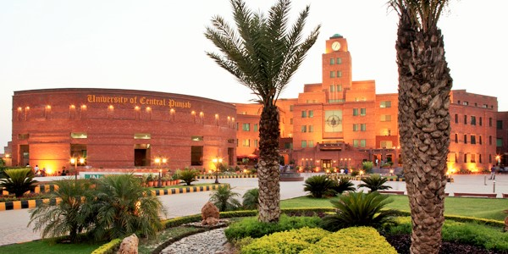
UNIVERSITY OF CENTRAL PUNJAB
Introduction
Department of Computer Sciences, Faculty of Information Technology (FOIT), University of Central Punjab, Lahore
Computer vision, image recognition, real-time, object detection, landmark recognition, and classification

Slide 3
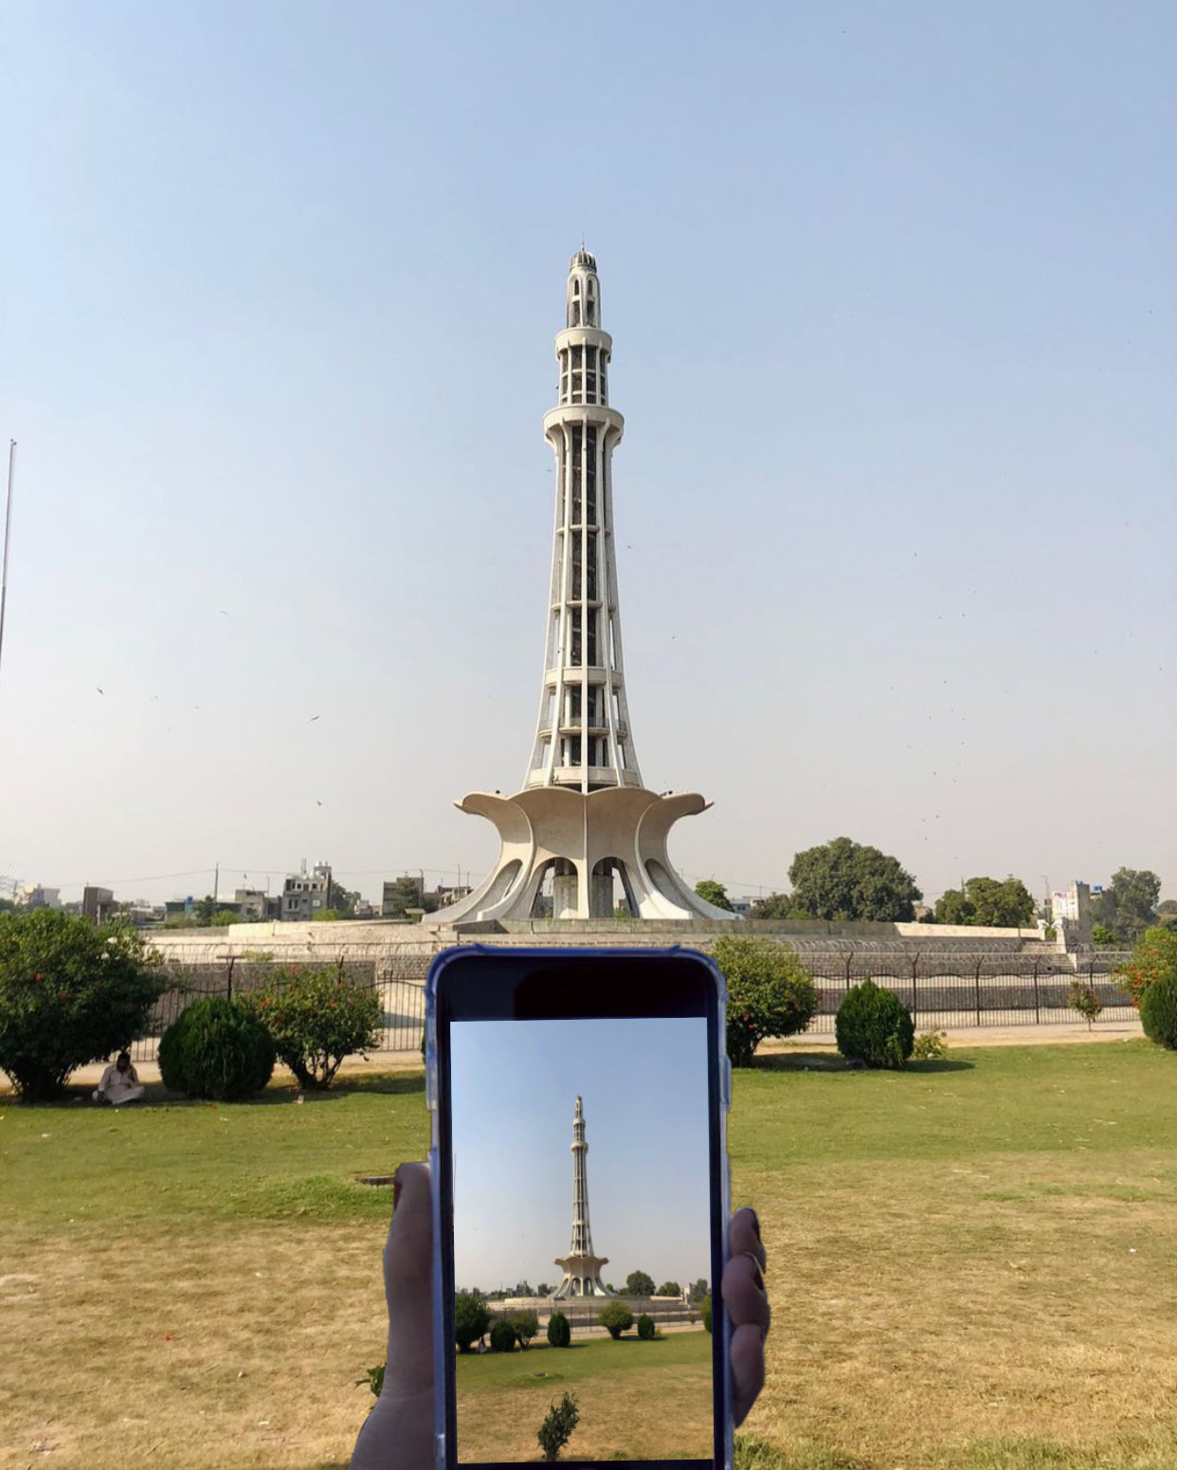
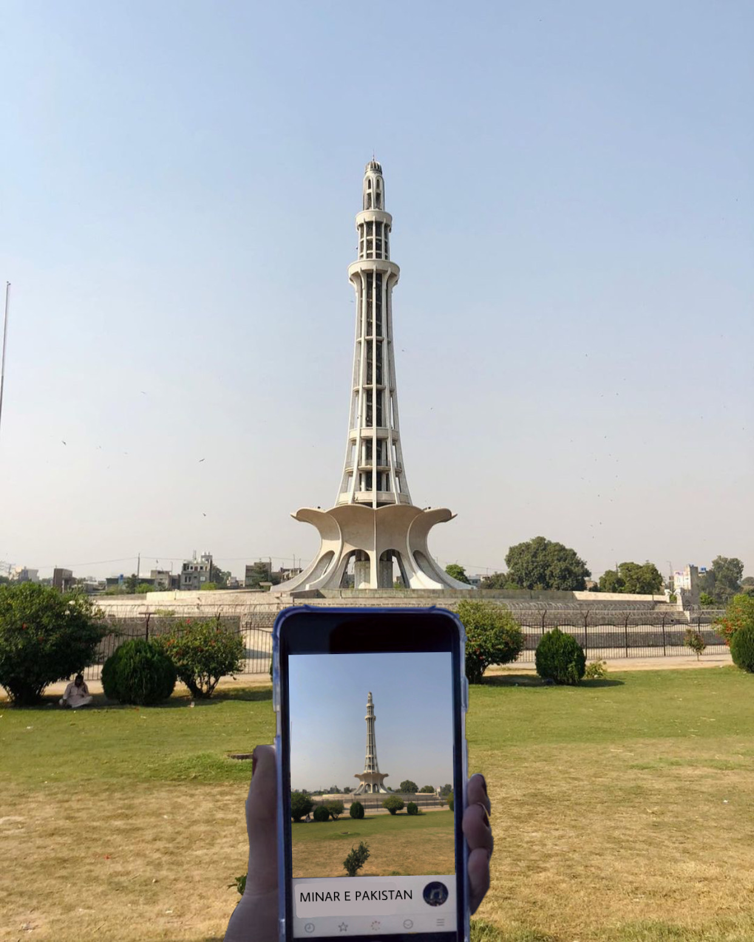
UNIVERSITY OF CENTRAL PUNJAB
Problem Statement
Real-time Camera Frames
Recognized Frame as Minar-e-Pakistan

Slide 4


UNIVERSITY OF CENTRAL PUNJAB
Industry Solutions
API
API

Slide 5
UNIVERSITY OF CENTRAL PUNJAB
Academia Solutions
Tour The World
Scene maps
Chinese Landmark Recognition
Indian Monument Recognition
Landmark Recognition at Cloud Mail.ru Group
Google Landmarks Recognition Challenge
A case study of Istanbul

Slide 6
UNIVERSITY OF CENTRAL PUNJAB
Results of Related Literature Work
 | Accuracy | Variance In Light | Variance in Angle/Size | Description | Geo-Info
Microsoft API | 11.8% | X | X | Cloud landmark recognition API | X
Google API | 35.7% | X | X | Cloud landmark recognition API | X
Tour The World | 46.3% | X | X | Image retrieval from a local landmark database | X
Scene Maps | 80.65% | X | X | Image retrieval from a local landmark database | X
Chinese Landmarks Recognition | 72.55% | X | X | iOS landmark recognition application | X
Indian Monument Recognition | 92.7% | X | ✓ | Framework for monument recognition | X
Cloud Mail.ru Group | 95% | X | ✓ | Landmark recognition framework deployed on Cloud-based application | ✓
Case Study of Istanbul | 96.3% | X | X | iOS landmark recognition application | X

Slide 7
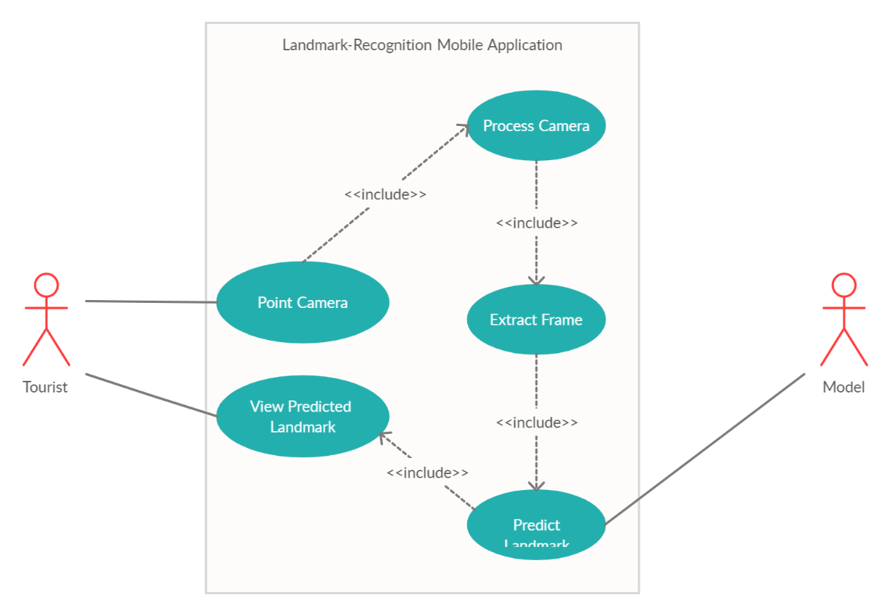
UNIVERSITY OF CENTRAL PUNJAB
System Boundary
System Boundary

Slide 8

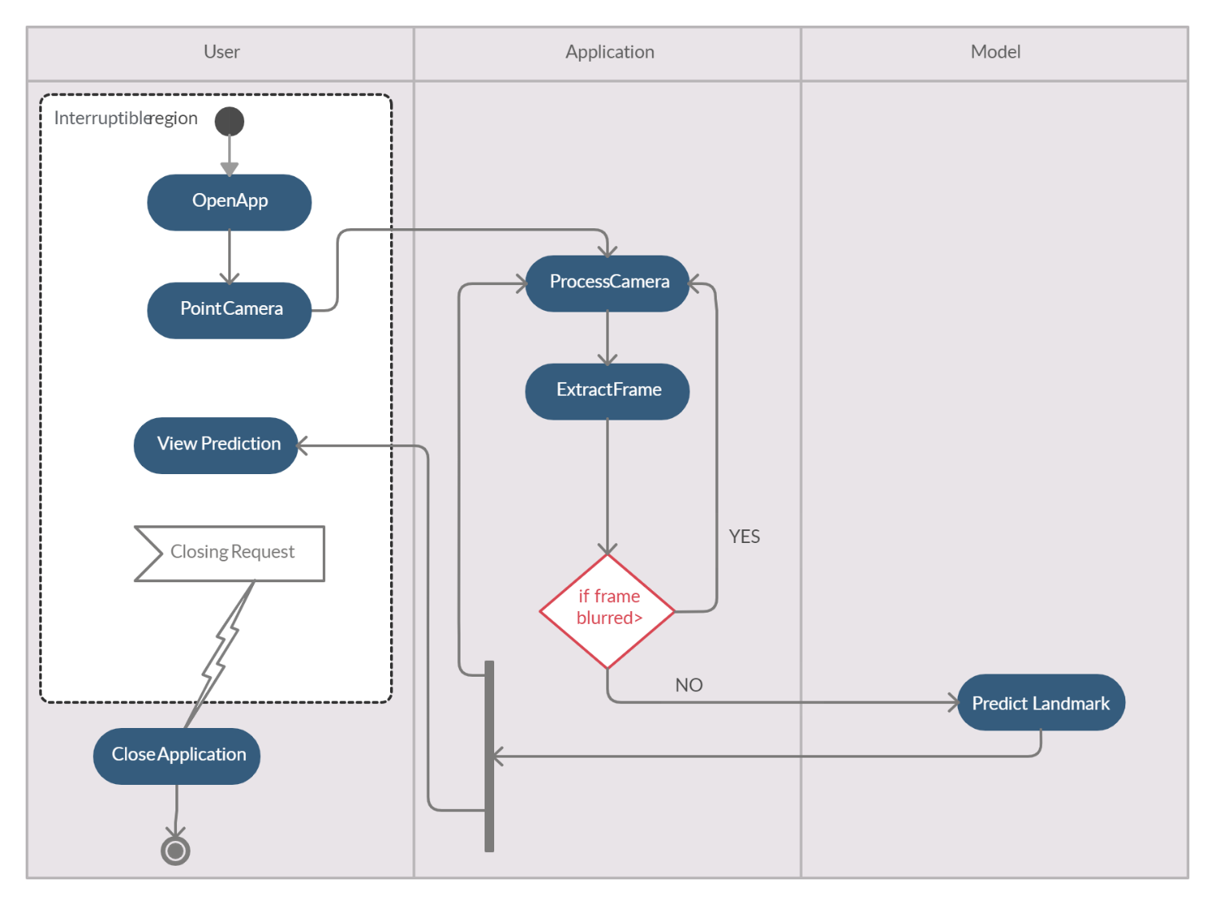
UNIVERSITY OF CENTRAL PUNJAB
System Interaction with External Entities
Tourist
System

Slide 9
UNIVERSITY OF CENTRAL PUNJAB
System Boundary
System
User

Slide 10
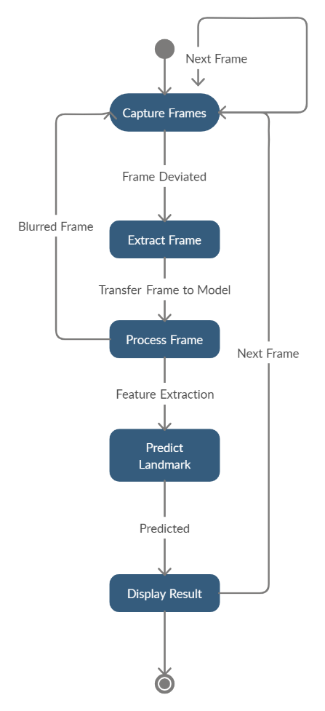
UNIVERSITY OF CENTRAL PUNJAB
System Interaction with External Entities
Tourist in Real-time Environment

Slide 11
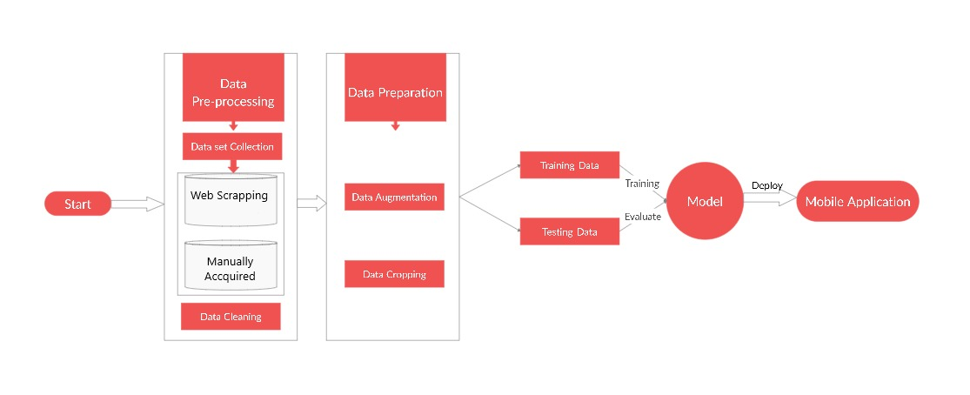
UNIVERSITY OF CENTRAL PUNJAB
Proposed System’s Workflow

Slide 12
UNIVERSITY OF CENTRAL PUNJAB
Project Understanding
Features
User scan landmark:
Process the device camera towards landmark
On behalf of deviation, system will extract a frame
System send extracted frame to model to predict the landmark
User is displayed the prediction at the bottom of the screen

Slide 13
UNIVERSITY OF CENTRAL PUNJAB
Project Understanding
Software Quality Attributes to be achieved:
Robustness
Usability
Reliability
Efficiency

Slide 14
UNIVERSITY OF CENTRAL PUNJAB
Project Understanding
Use Cases:
UC-1: Point Camera
UC-2: Process Camera
UC-3: Extract Frame
UC-4: Predict Landmark
UC-5: View Predicted Landmark

Slide 15
UNIVERSITY OF CENTRAL PUNJAB
Project Understanding
Scenarios
Some scenarios of the system are stated in the next slides

Slide 16
UNIVERSITY OF CENTRAL PUNJAB
Project Understanding
Scenarios:
S-1: Tourist points the camera towards a landmark in a real-time environment. The system processes the camera and extracts the frame to predict the landmark using the deep learning model.
Alternate S-1: Tourist is point camera towards a landmark in a real-time environment with no connectivity. The system will alert the user to connect to the internet via a dialog box.

Slide 17
UNIVERSITY OF CENTRAL PUNJAB
Project Understanding
Scenarios:
S-2: The model predicts the given frame by the tourist. The system presents the predicted landmark name, some description via text or speed assistant.
Alternate S-2: Model is not able to predict the given frame by the tourist because the prediction accuracy does not meet the threshold. The system does not show the prediction and continue checking with the incoming frames.

Slide 18
UNIVERSITY OF CENTRAL PUNJAB
Project Understanding
Activity Diagram:

Slide 19
UNIVERSITY OF CENTRAL PUNJAB
Initial Results
Dataset Collection for the landmarks of Lahore
Ways??

Slide 20
UNIVERSITY OF CENTRAL PUNJAB
Initial Results
Dataset Collection for the landmarks of Lahore
Ways??
Dataset Collection via Web Scraping?

Slide 21
UNIVERSITY OF CENTRAL PUNJAB
Initial Results
Dataset Collection for the landmarks of Lahore
Ways??
Dataset Collection via Web Scraping?
The dataset was collected for 11 landmarks of Lahore via web scraping using Image APIs from Google and Microsoft, and frames extraction through Youtube videos to test the web scraping collection approach

Slide 22
UNIVERSITY OF CENTRAL PUNJAB
Initial Results
Total images collected via web scraping was around 3000 and most of them contained filters

Slide 23
UNIVERSITY OF CENTRAL PUNJAB
Initial Results
Total images collected via web scraping was around 3000 and most of them contained filters
After cleaning, around 1000 images were left for 11 classes of the landmarks of Lahore

Slide 24
UNIVERSITY OF CENTRAL PUNJAB
Initial Results
Total images collected via web scraping was around 3000 and most of them contained filters
After cleaning, around 1000 images were left for 11 classes of the landmarks of Lahore
Initial results contained the experiments for the collected dataset using pretrained image classification models and models built from scratch

Slide 25
UNIVERSITY OF CENTRAL PUNJAB
Initial Results
Pretrained image classification models network architecture
Example VGG-16

Slide 26

UNIVERSITY OF CENTRAL PUNJAB
Initial Results
VGG-16

Slide 27
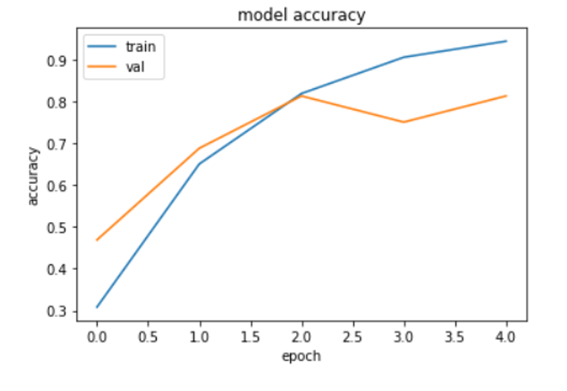
UNIVERSITY OF CENTRAL PUNJAB
Initial Experiments
Experiment 1
Method VGG-16

Slide 28
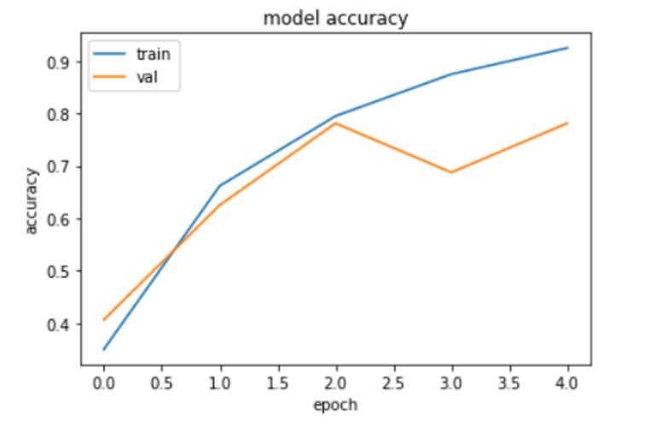
UNIVERSITY OF CENTRAL PUNJAB
Initial Experiments
Experiment 2
Method VGG-19

Slide 29
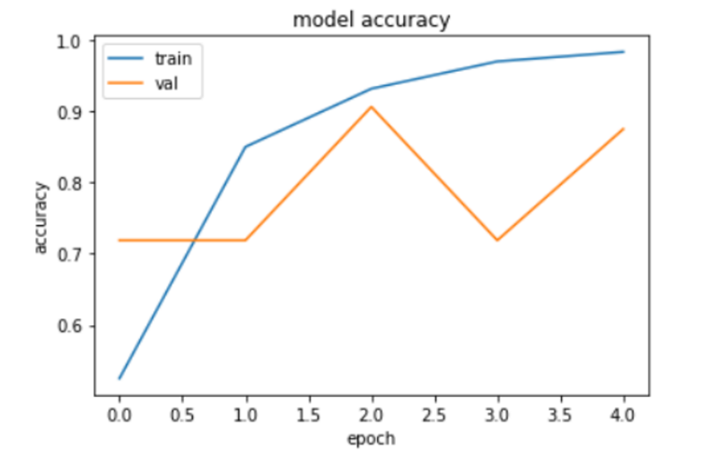
UNIVERSITY OF CENTRAL PUNJAB
Initial Experiments
Experiment 3
Method ResNet-50

Slide 30
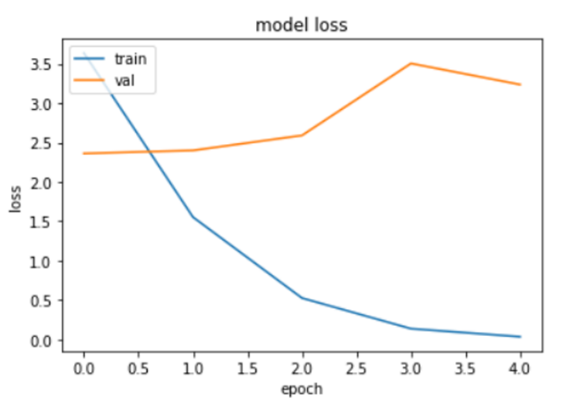
UNIVERSITY OF CENTRAL PUNJAB
Initial Experiments
Experiment 4
Method 3-layered CNN on Greyscale Images

Slide 31
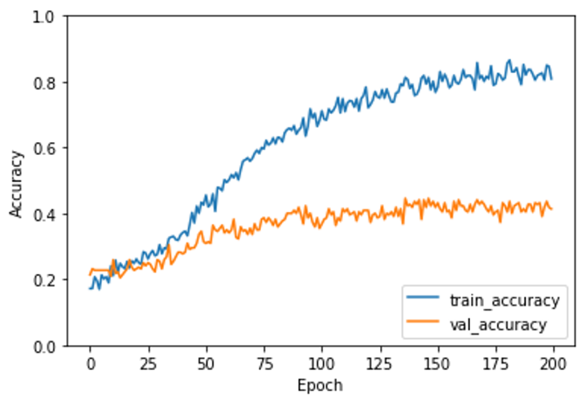
UNIVERSITY OF CENTRAL PUNJAB
Initial Experiments
Experiment 5
Method 7-layered CNN on RGB Images

Slide 32
UNIVERSITY OF CENTRAL PUNJAB
Initial Results Achieved
Methods | Accuracy
VGG-16 | 77.5%
VGG-19 | 70%
ResNet-50 | 87.5%
CNN (Greyscale) | 32%
CNN (RGB) | 41%

Slide 33
UNIVERSITY OF CENTRAL PUNJAB
Issues in Initial Results??

Slide 34
UNIVERSITY OF CENTRAL PUNJAB
Issues in Initial Results
Models on which the experiments were run are deep learning models
Because deep learning models are best for image classification/recognition problems

Slide 35
UNIVERSITY OF CENTRAL PUNJAB
Issues in Initial Results
Models on which the experiments were run are deep learning models
Because deep learning models are best for image classification/recognition problems
Deep learning is data hungry, its algorithms requires as much as labelled samples of a problem space

Slide 36
UNIVERSITY OF CENTRAL PUNJAB
Issues in Initial Results
Models on which the experiments were run are deep learning models
Because deep learning models are best for image classification/recognition problems
Deep learning is data hungry, its algorithms requires as much as labelled samples of a problem space
Very less amount of data

Slide 37
UNIVERSITY OF CENTRAL PUNJAB
Why It Doesn’t Work!
Deep learning currently lacks in mechanism for learning abstractions

Slide 38
UNIVERSITY OF CENTRAL PUNJAB
Why It Doesn’t Work!
Deep learning currently lacks in mechanism for learning abstractions
So, it is the overfitting case for the experiments run because of very less data

Slide 39
UNIVERSITY OF CENTRAL PUNJAB
What’s Next
There should be some other way for collecting the dataset for the famous landmarks of Lahore??

Slide 40
UNIVERSITY OF CENTRAL PUNJAB
What’s Next
There should be some other way for collecting the dataset for the famous landmarks of Lahore??
Yes

Slide 41
UNIVERSITY OF CENTRAL PUNJAB
What’s Next
There should be some other way for collecting the dataset for the famous landmarks of Lahore??
Yes
Another possible technique was proposed to collect the dataset of the famous landmarks of Lahore
“Manual Collection of Dataset”

Slide 42
UNIVERSITY OF CENTRAL PUNJAB
Collaboration for Manual Dataset Collection
Collaborated with “Walled City of Lahore Authority” to manually collect the dataset of the famous landmarks of Lahore

Slide 43
UNIVERSITY OF CENTRAL PUNJAB
Collaboration for Manual Dataset Collection
Collaborated with “Walled City of Lahore Authority” to manually collect the dataset of the famous landmarks of Lahore
Provided with a tourist guide to help us make that possible

Slide 44
UNIVERSITY OF CENTRAL PUNJAB
Collaboration for Manual Dataset Collection
Collaborated with “Walled City of Lahore Authority” to manually collect the dataset of the famous landmarks of Lahore
Provided with a tourist guide to help us make that possible
Collected more than 31 thousand images for the 25 famous landmarks of Walled City of Lahore

Slide 45
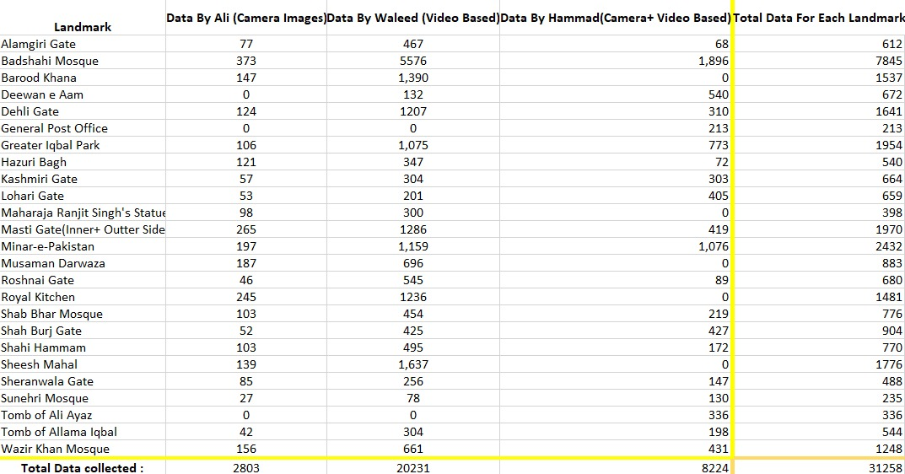
UNIVERSITY OF CENTRAL PUNJAB
Collected Dataset Analysis

Slide 46
UNIVERSITY OF CENTRAL PUNJAB
Collected Dataset Analysis
Strategies for dataset collection:
1. Camera Based Images(Ali Sehran)
To cover the desired and specific angles with attention
2. Video Based Images(Waleed Kamran)
To cover the angles and views missed unconsciously
3. Camera + Video Based(Muhammad Hammad)
To cover all desired and specific angles and views of the landmarks

Slide 47
UNIVERSITY OF CENTRAL PUNJAB
Target Final Results
 | Accuracy | Variance In Light | Variance in Angle/Size | Description | Geo-Info
Microsoft API | 11.8% | X | X | Cloud landmark recognition API | X
Google API | 35.7% | X | X | Cloud landmark recognition API | X
Tour The World | 46.3% | X | X | Image retrieval from a local landmark database | X
Scene Maps | 80.65% | X | X | Image retrieval from a local landmark database | X
Chinese Landmarks Recognition | 72.55% | X | X | iOS landmark recognition application | X
Indian Monument Recognition | 92.7% | X | ✓ | Framework for monument recognition | X
Cloud Mail.ru Group | 95% | X | ✓ | Landmark recognition framework deployed on Cloud-based application | ✓
Case Study of Istanbul | 96.3% | X | X | iOS landmark recognition application | X
Our Proposed Solution | 80%+ | ✓ | ✓ | Android/cross-platform landmark recognition application | Maybe

Slide 48
UNIVERSITY OF CENTRAL PUNJAB
Future Directions for Phase-2
Several data augmentation technique’s literature review is in process and will be applied for increasing the labelled samples of the problem space
Pre processing
Model training

Slide 49
UNIVERSITY OF CENTRAL PUNJAB
Phase 2

Slide 50
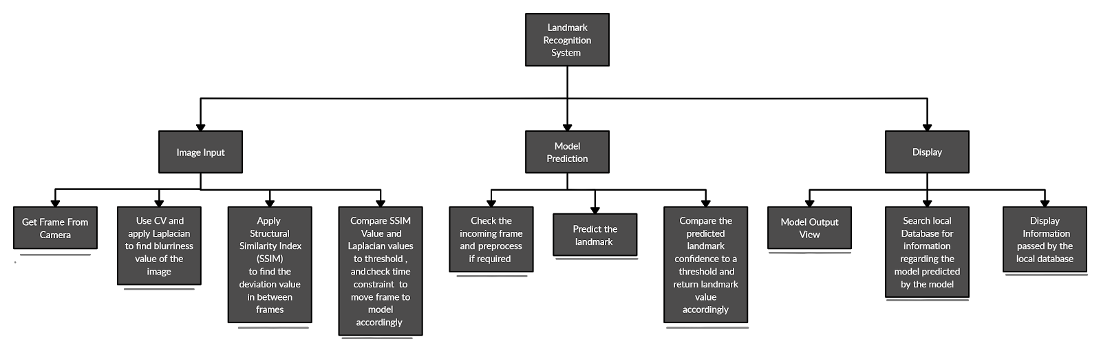
UNIVERSITY OF CENTRAL PUNJAB
System Decomposition

Slide 51
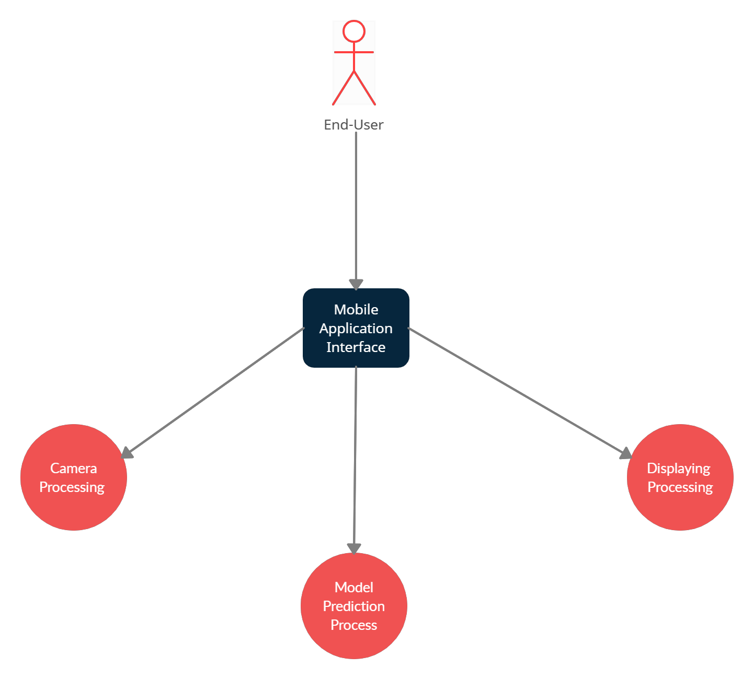
UNIVERSITY OF CENTRAL PUNJAB
System Design Pattern
Facade Design Pattern

Slide 52
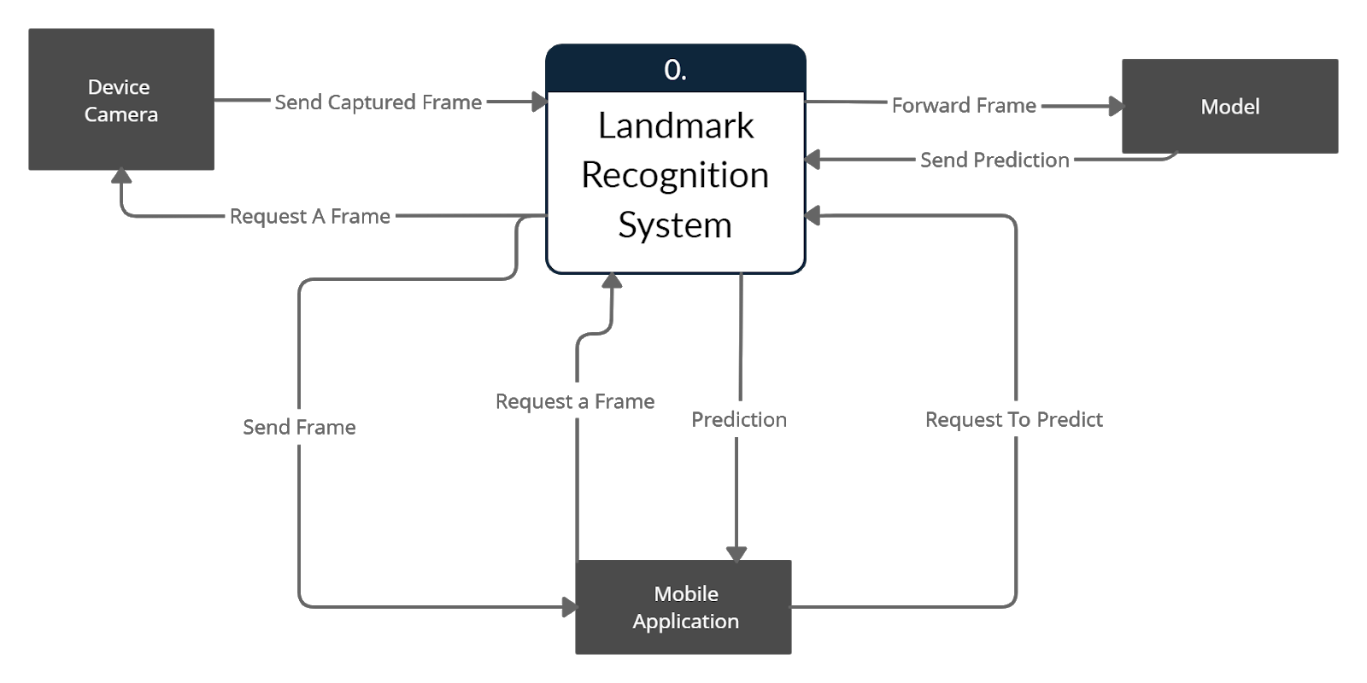
UNIVERSITY OF CENTRAL PUNJAB
Relationship b/w Components in System

Slide 53
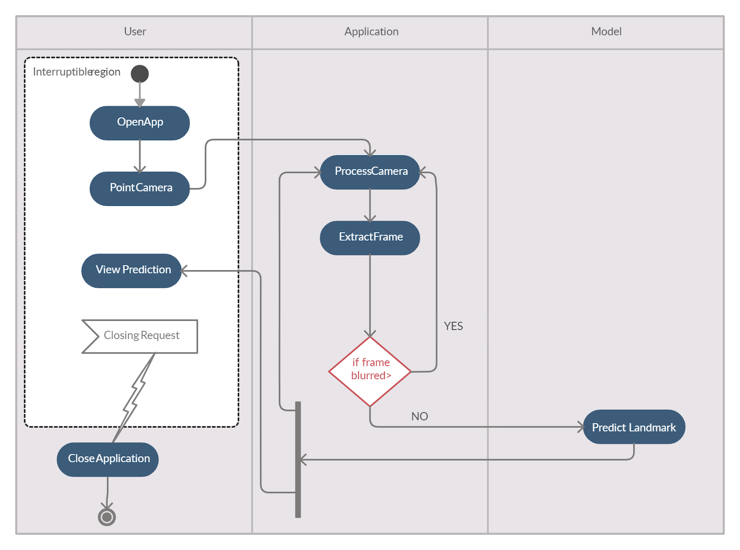
UNIVERSITY OF CENTRAL PUNJAB
Relationship b/w Components in System

Slide 54
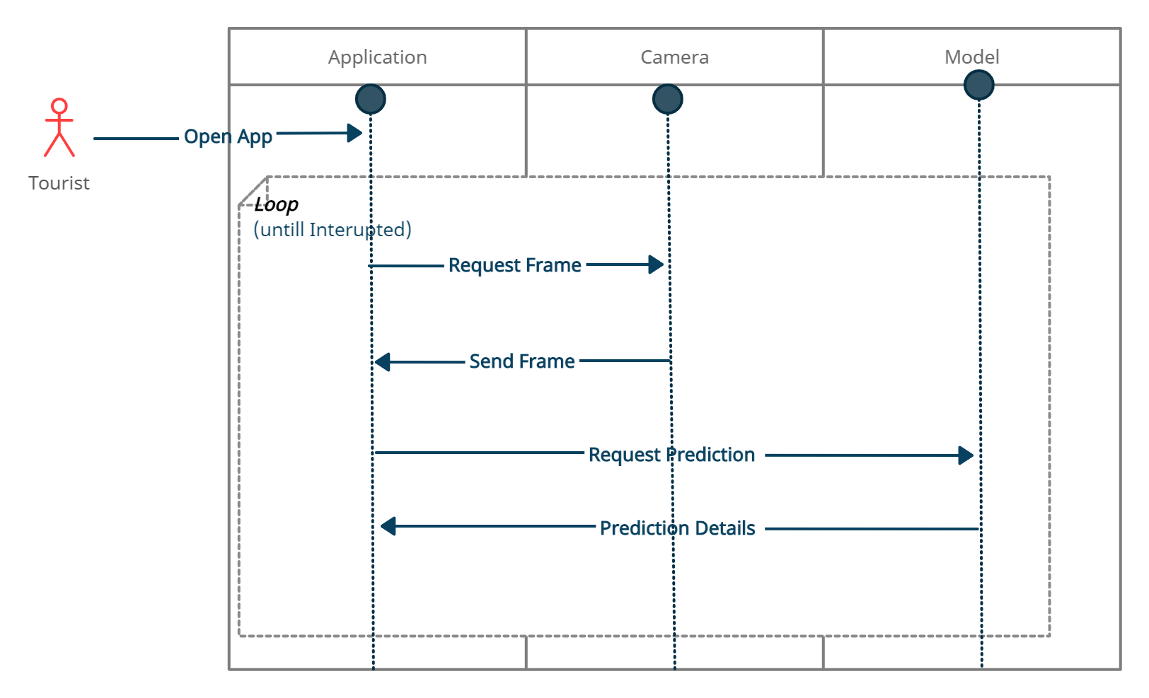
UNIVERSITY OF CENTRAL PUNJAB
Interactions b/w System Processes
Event Diagram

Slide 55
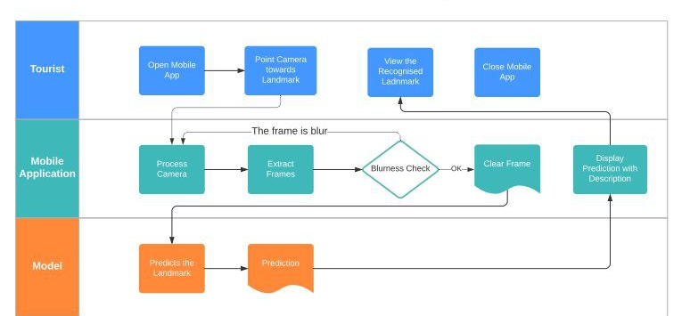
UNIVERSITY OF CENTRAL PUNJAB
Interactions b/w System Processes
System Swim-lane

Slide 56
UNIVERSITY OF CENTRAL PUNJAB
Interactions b/w System Processes
DFD – Context Level

Slide 57
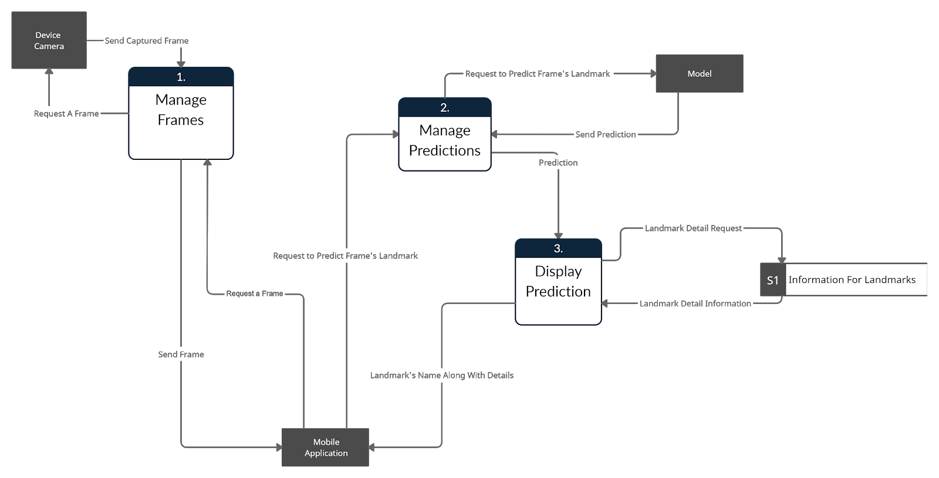
UNIVERSITY OF CENTRAL PUNJAB
Interactions b/w System Processes
DFD – Level 0

Slide 58
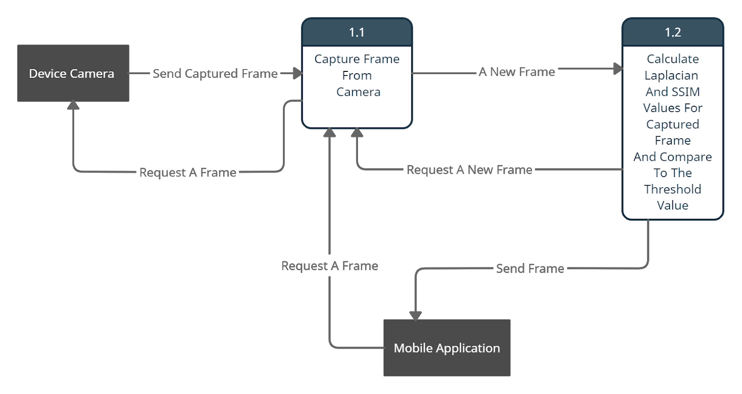
UNIVERSITY OF CENTRAL PUNJAB
Interactions b/w System Processes
DFD – Level 1, Process 1

Slide 59
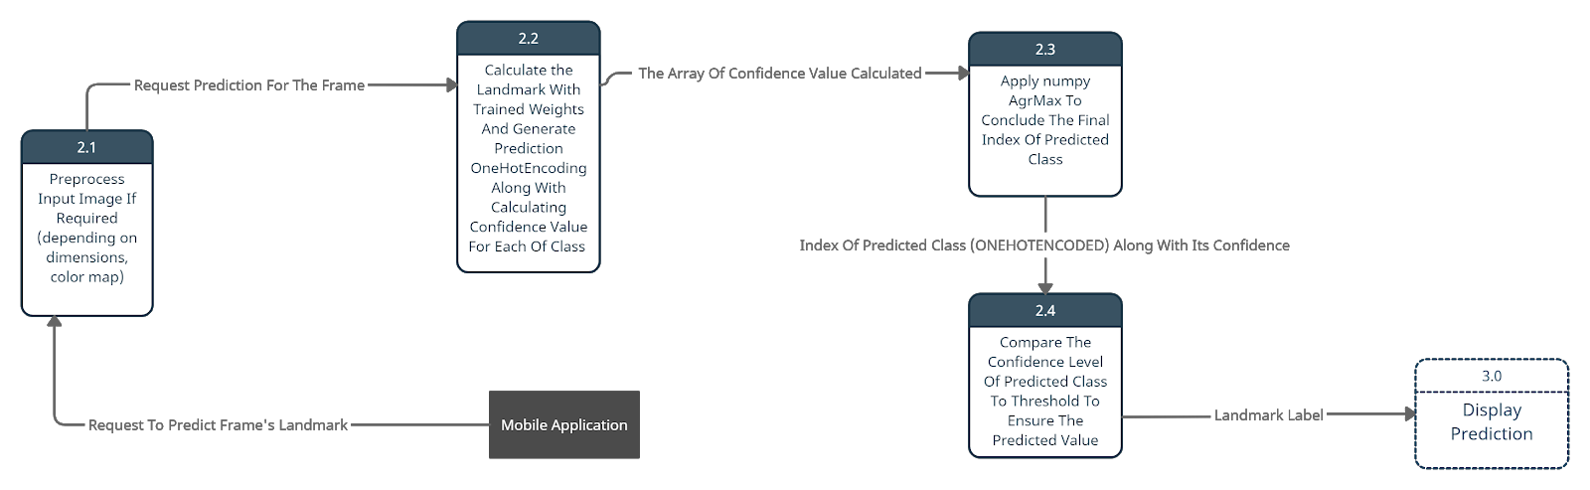
UNIVERSITY OF CENTRAL PUNJAB
Interactions b/w System Processes
DFD – Level 1, Process 2

Slide 60
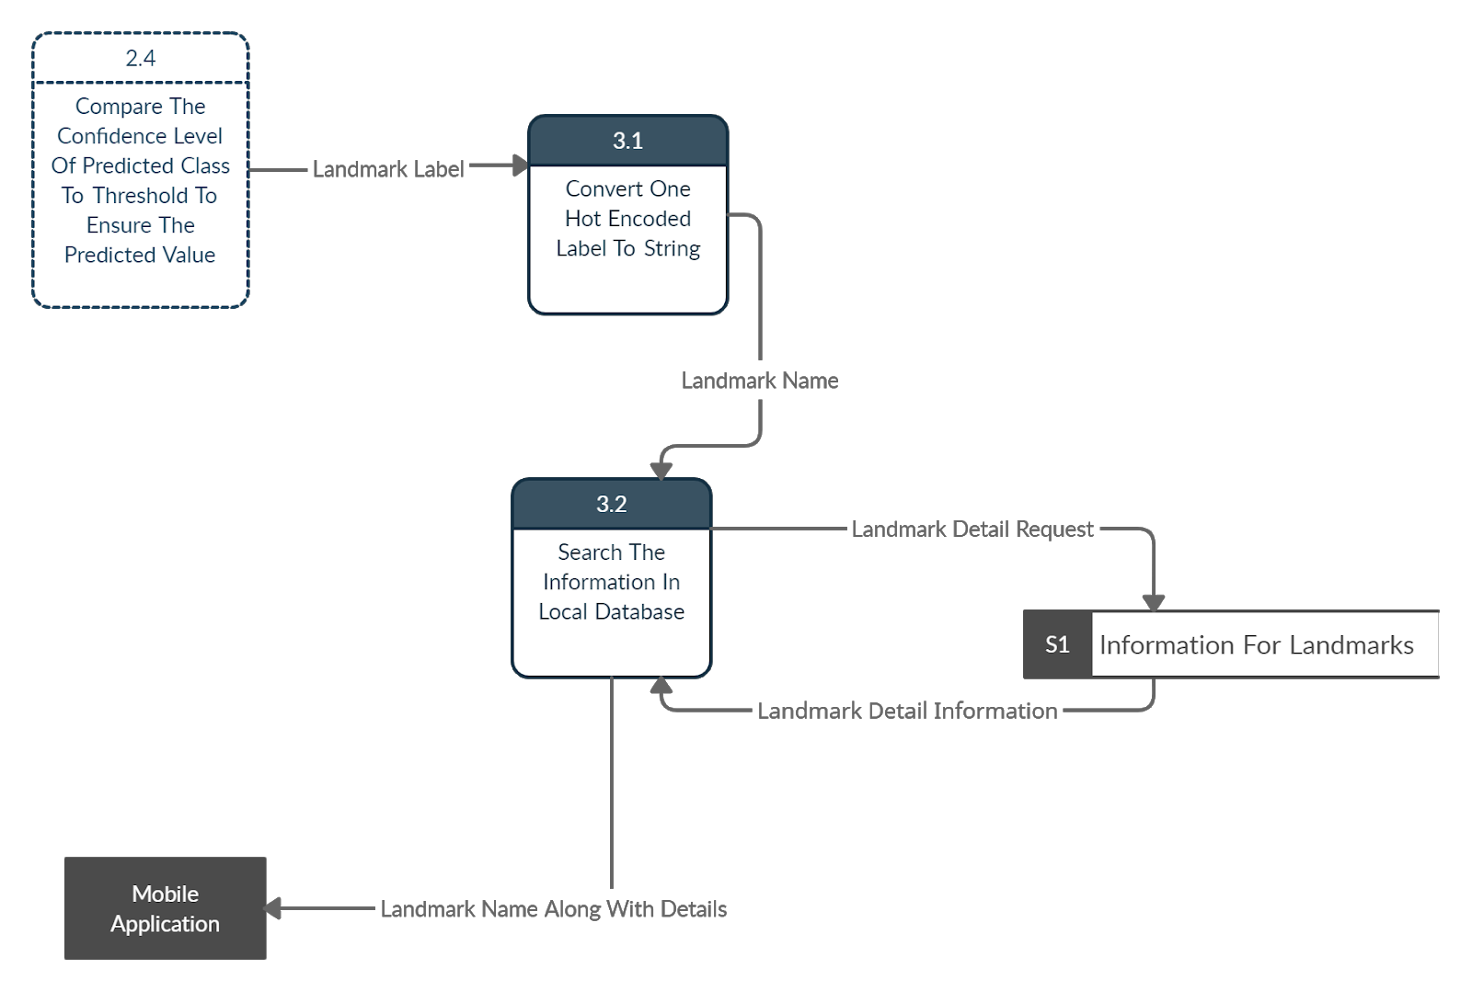
UNIVERSITY OF CENTRAL PUNJAB
Interactions b/w System Processes
DFD – Level 1, Process 3

Slide 61
UNIVERSITY OF CENTRAL PUNJAB
Directions for Phase-2
Several data augmentation technique’s literature review is in process and will be applied for increasing the labelled samples of the problem space
Pre processing
Model training
These were our main targets for phase 2!!

Slide 62
UNIVERSITY OF CENTRAL PUNJAB
Directions for Phase-2
Several data augmentation technique’s literature review is in process and will be applied for increasing the labelled samples of the problem space
Horizontal flipping
Vertical flipping
Brightness range = [0.2,1.0]
Fill mode="constant”
with (Zero Padding)
Rotation Ranges[0-50]
After literature review and discussion with supervisor, some pre-processing techniques were finalized for the experimentation involving data augmentation

Slide 63
UNIVERSITY OF CENTRAL PUNJAB
Directions for Phase-2
Pre processing
In pre-processing, manual cropping was done in images involving more than one landmarks in a single image, the images were resized to the dimensions which are compatible with pre-trained models like Resnet, VGGNet, InceptionNet
Other used pre-processing techniques include rgb to grayscale, rotation and zoom ranges, horizontally and vertically flipping of images for data augmentation

Slide 64
UNIVERSITY OF CENTRAL PUNJAB
Directions for Phase-2
Model training
Several experiments were carried out for model training on pre-trained models with weights and without weights, with augmentation and without augmentation, with parts of landmarks images and just whole landmarks images

Slide 65
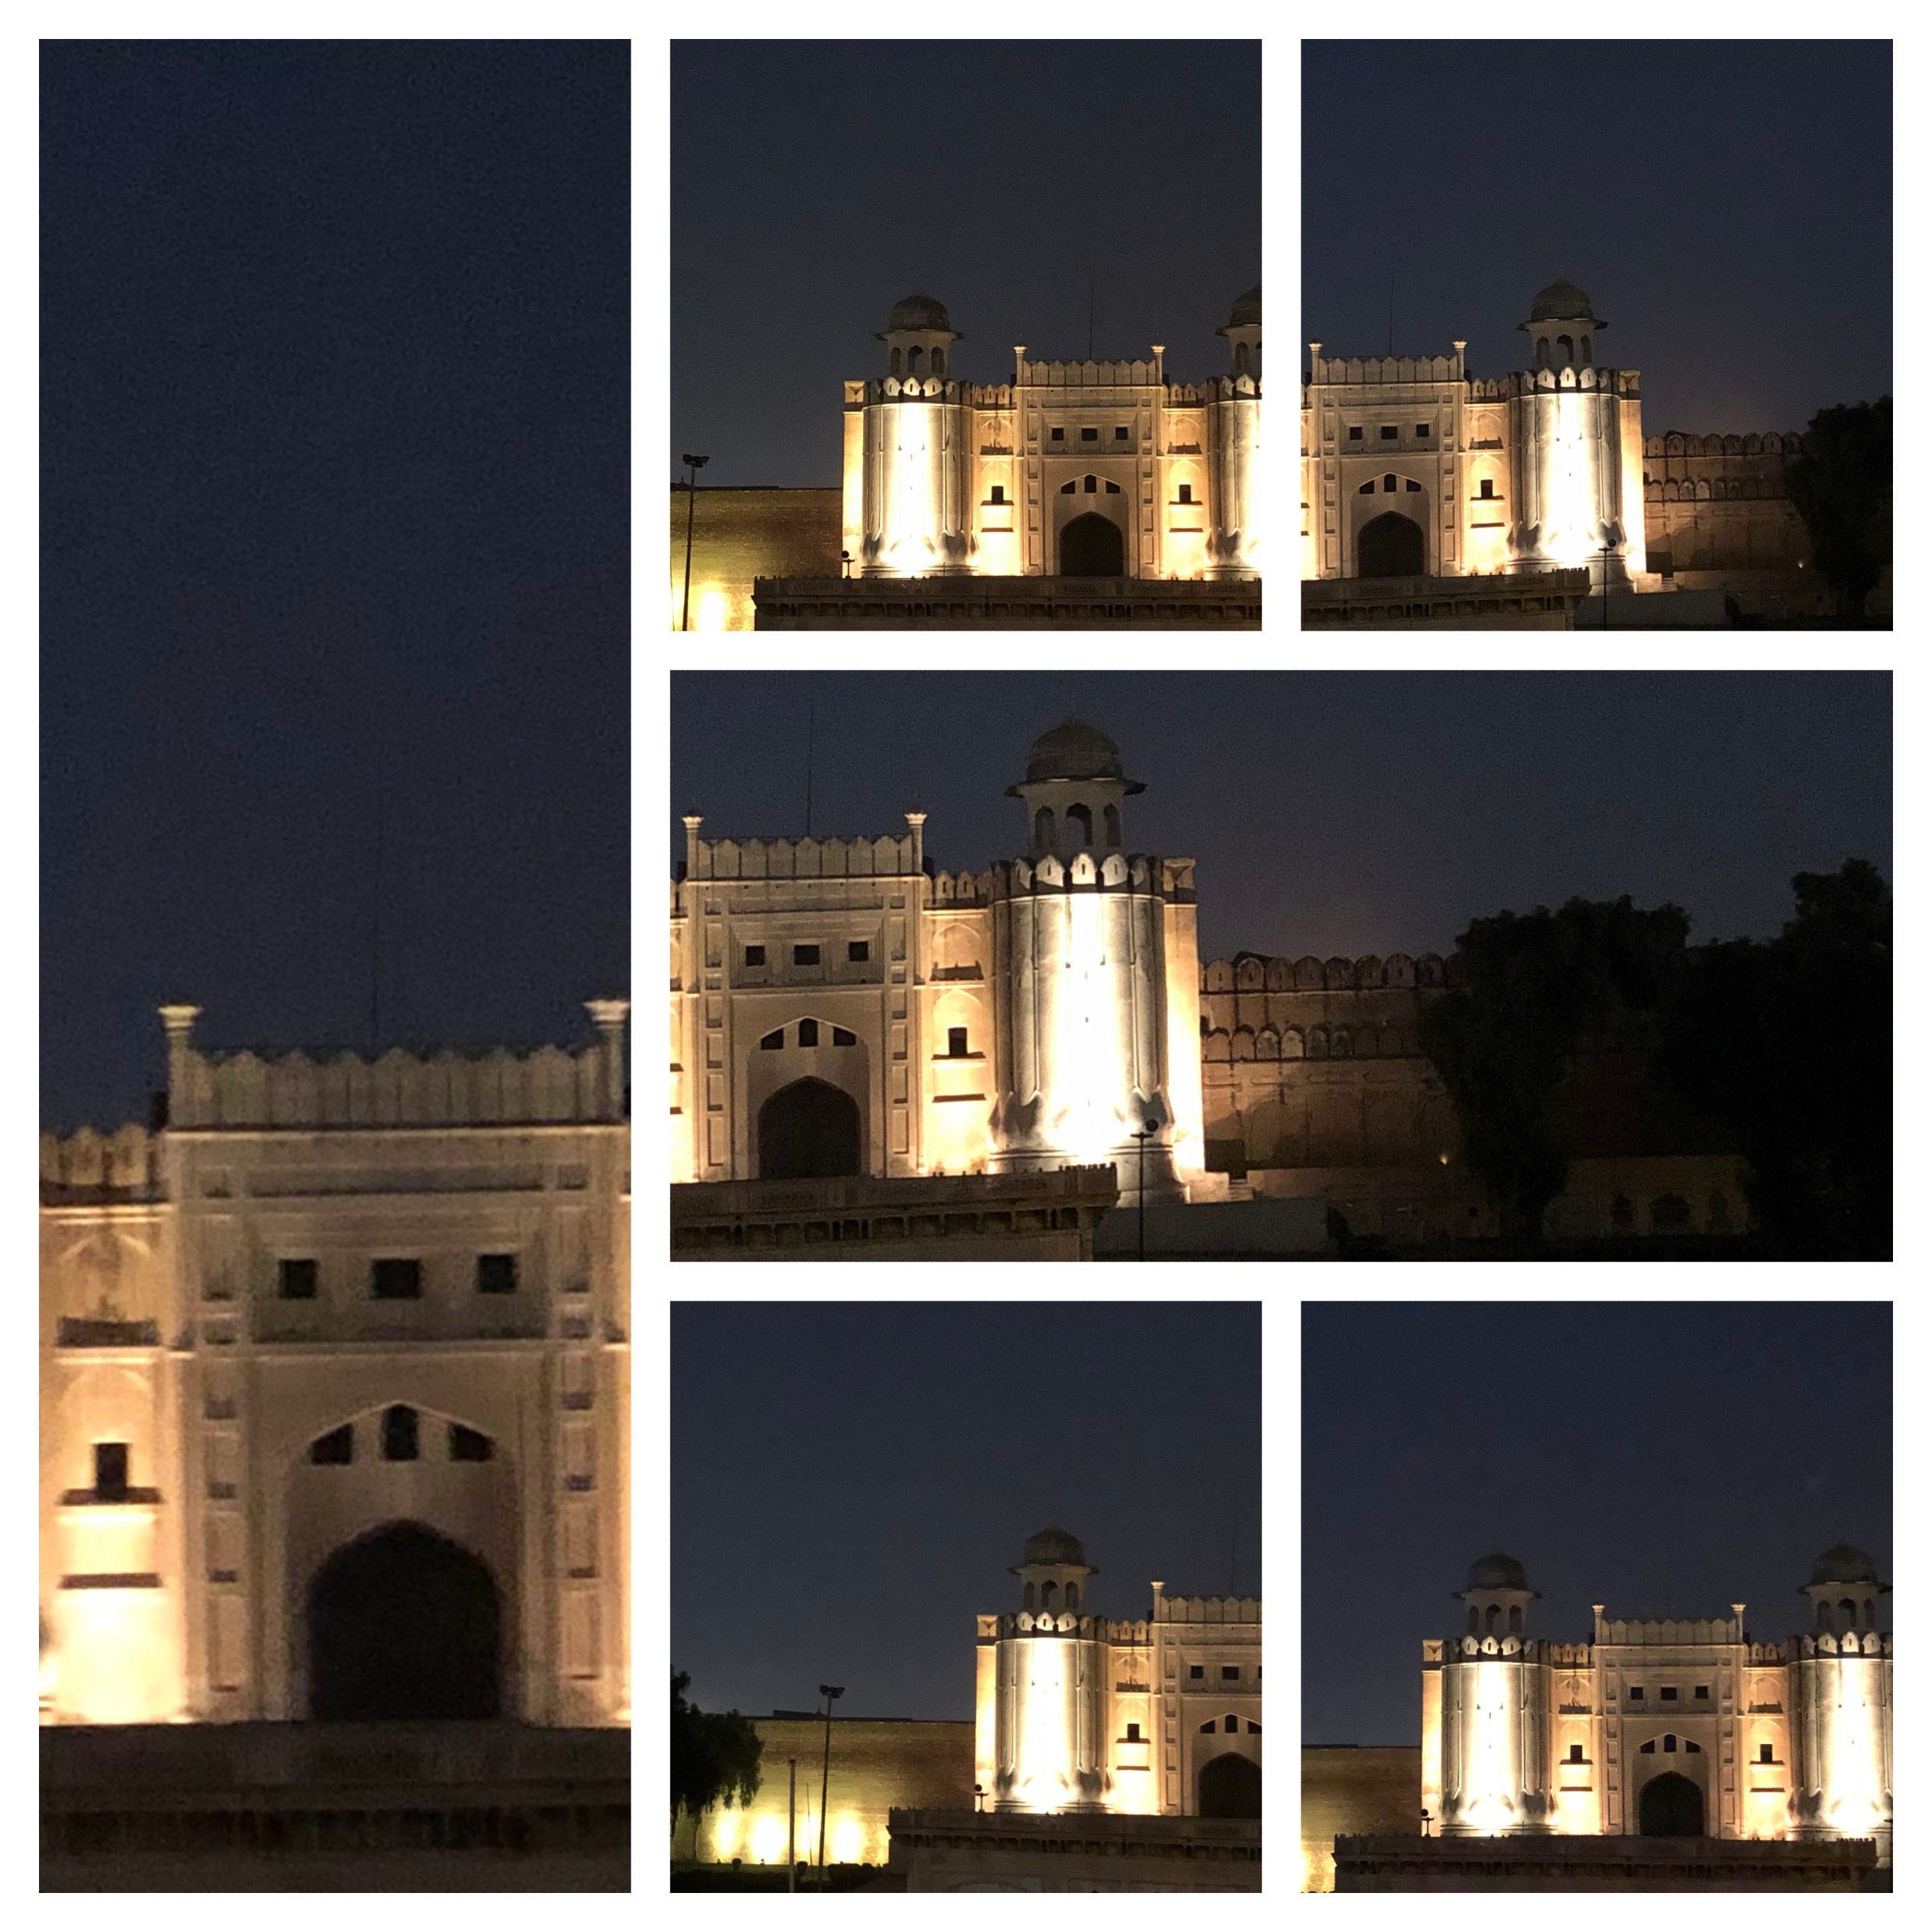
UNIVERSITY OF CENTRAL PUNJAB
Dataset Variation
Whole + Parts of Landmarks

Slide 66
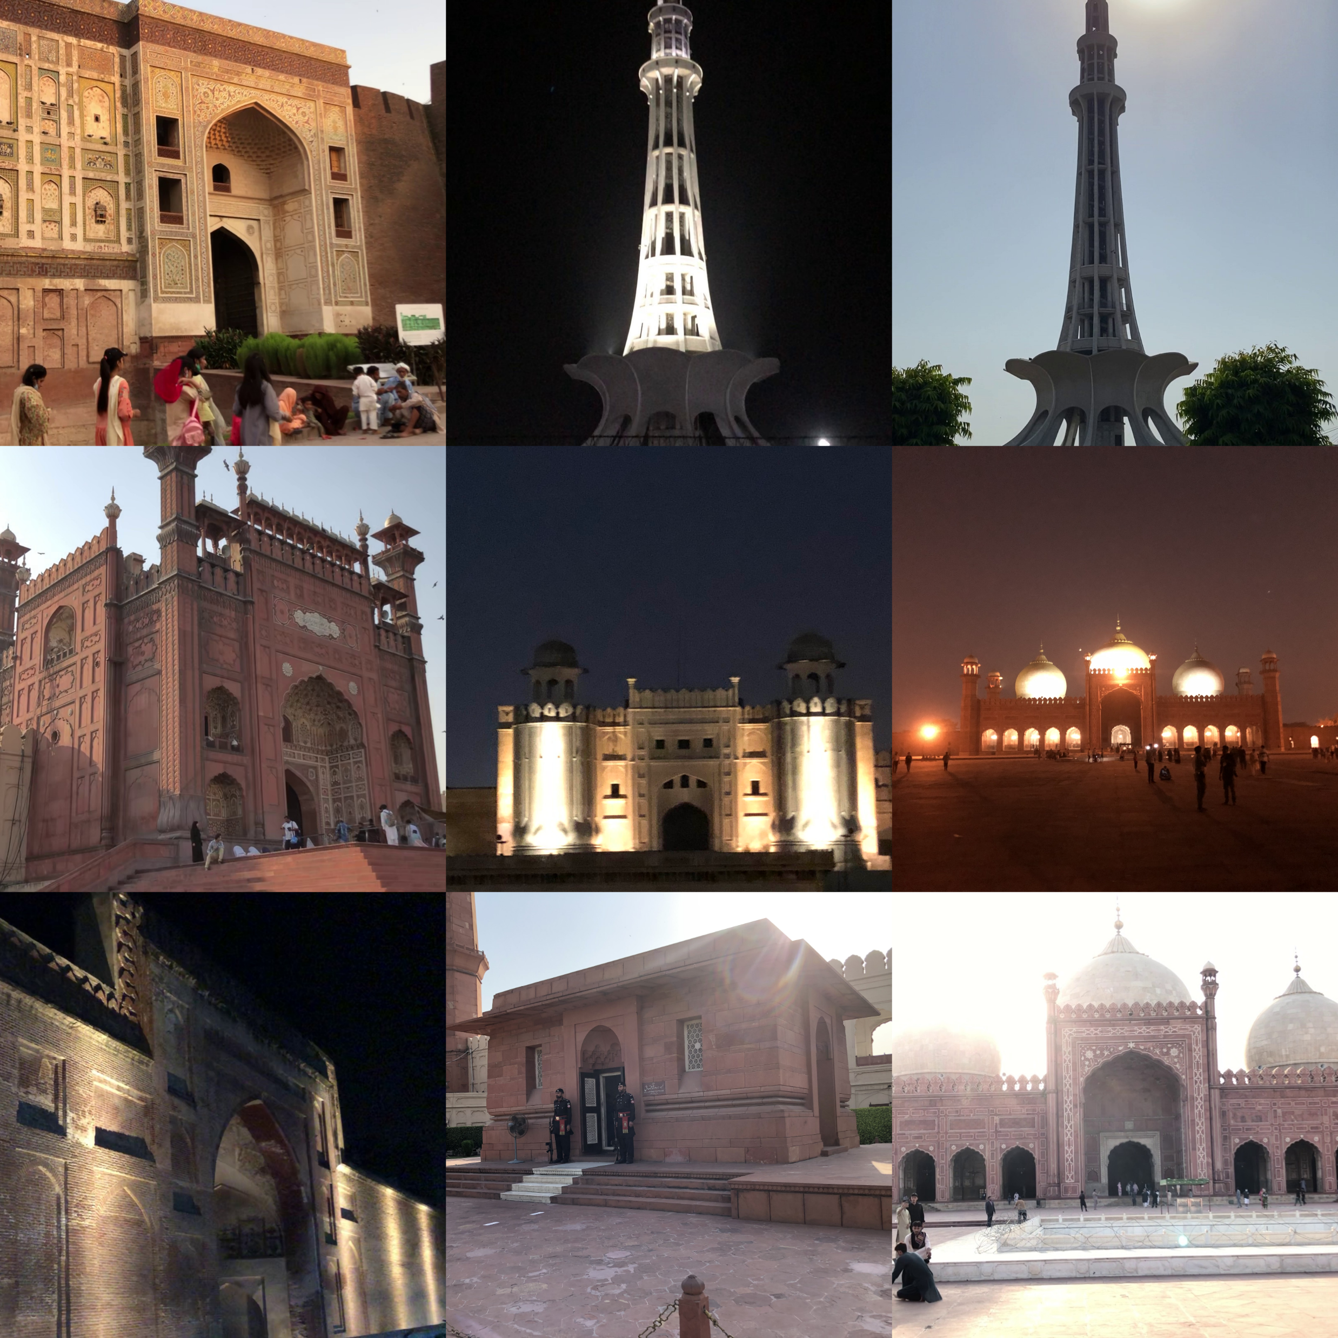
UNIVERSITY OF CENTRAL PUNJAB
Dataset Variation
Whole Landmarks

Slide 67
UNIVERSITY OF CENTRAL PUNJAB
Experimentation Results and Analysis
Models
Resnet-50
Resnet-50 Architecture
InceptionV3 Architecture
VGG-16
We were asked to use early stopping and to show confusion matrix of the models in Phase 1 presentation, so we have used early stopping for comparison in few experiments and confusion matrix of every experiment this time

Slide 68
UNIVERSITY OF CENTRAL PUNJAB
Experimentation Results and Analysis
Models were experimented on grayscale images as well, due to color variation of some landmarks like Hazuri Bagh because of weather seasons after discussing with experts in Faculty (FoIT)
Testing set (unseen) was manually created from the whole dataset consisting of 681 images

Slide 69
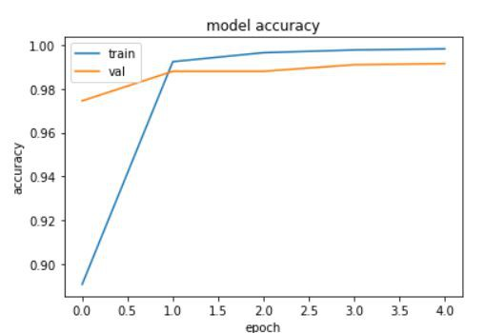
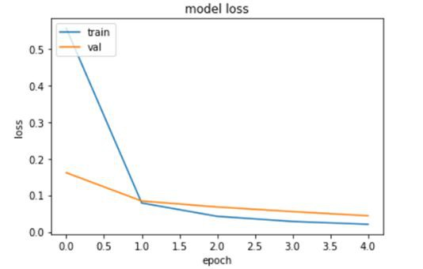
UNIVERSITY OF CENTRAL PUNJAB
Experimentation Results and Analysis
Pre-trained Resnet 50 with Augmentation & without Early Stopping Criteria on RGB images and Whole + Parts Dataset

Slide 70
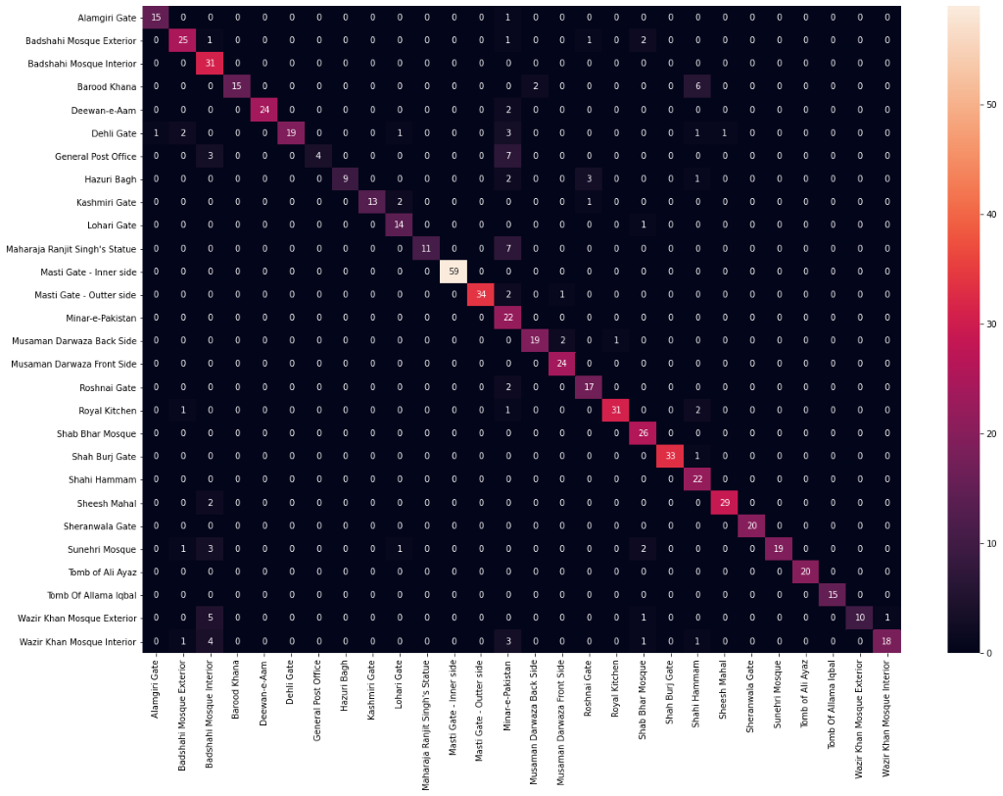
UNIVERSITY OF CENTRAL PUNJAB
Experimentation Results and Analysis
Confusion Matrix

Slide 71
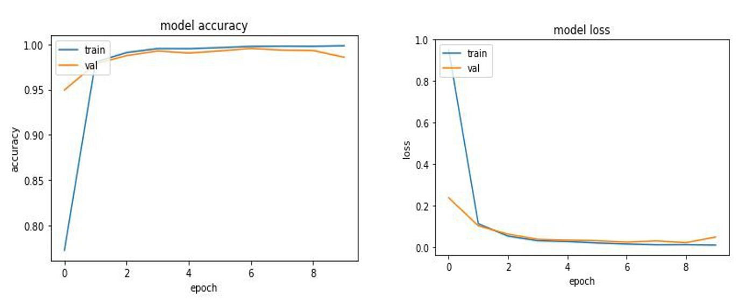
UNIVERSITY OF CENTRAL PUNJAB
Experimentation Results and Analysis
Pre-trained Resnet 50 with further 3 fully connected layers without Early Stopping Criteria on RGB images and Whole Dataset

Slide 72
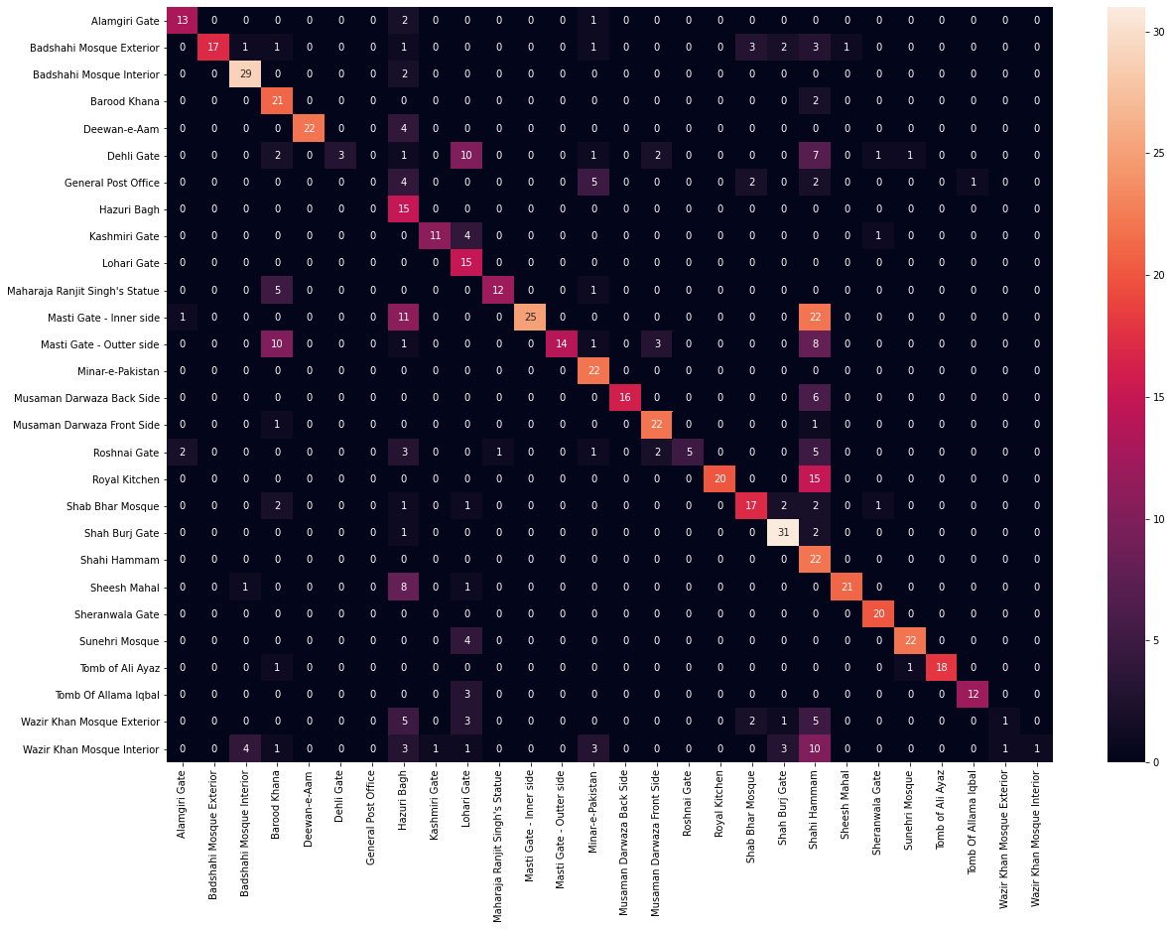
UNIVERSITY OF CENTRAL PUNJAB
Experimentation Results and Analysis
Confusion Matrix
Notes:
Conclusion:
For model trained on whole landmark’s dataset(Model-2) early stopping fully performed its task yet its not as accurate as ResNet (model-1) trained on whole + cropped even if that was stopped due to time constraints.

Slide 73
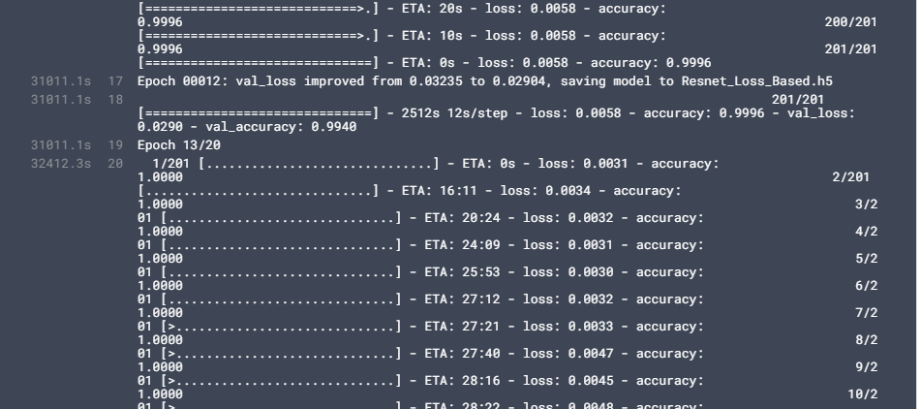
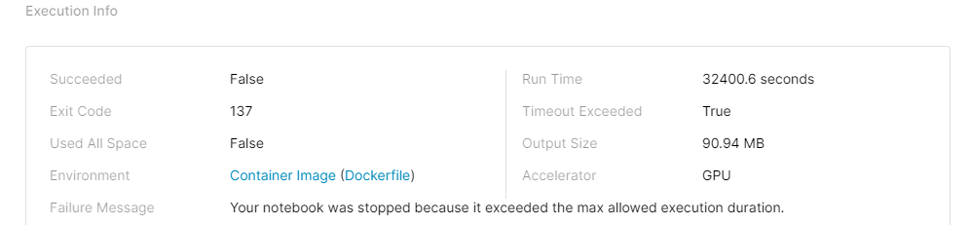
UNIVERSITY OF CENTRAL PUNJAB
Experimentation Results and Analysis
Pre-trained Resnet 50 with Augmentation & with Early Stopping Criteria on RGB images and Whole + Parts Dataset
Error: Execution Time out (9 hours +)
-> Accuracy Touched 0.99

Slide 74
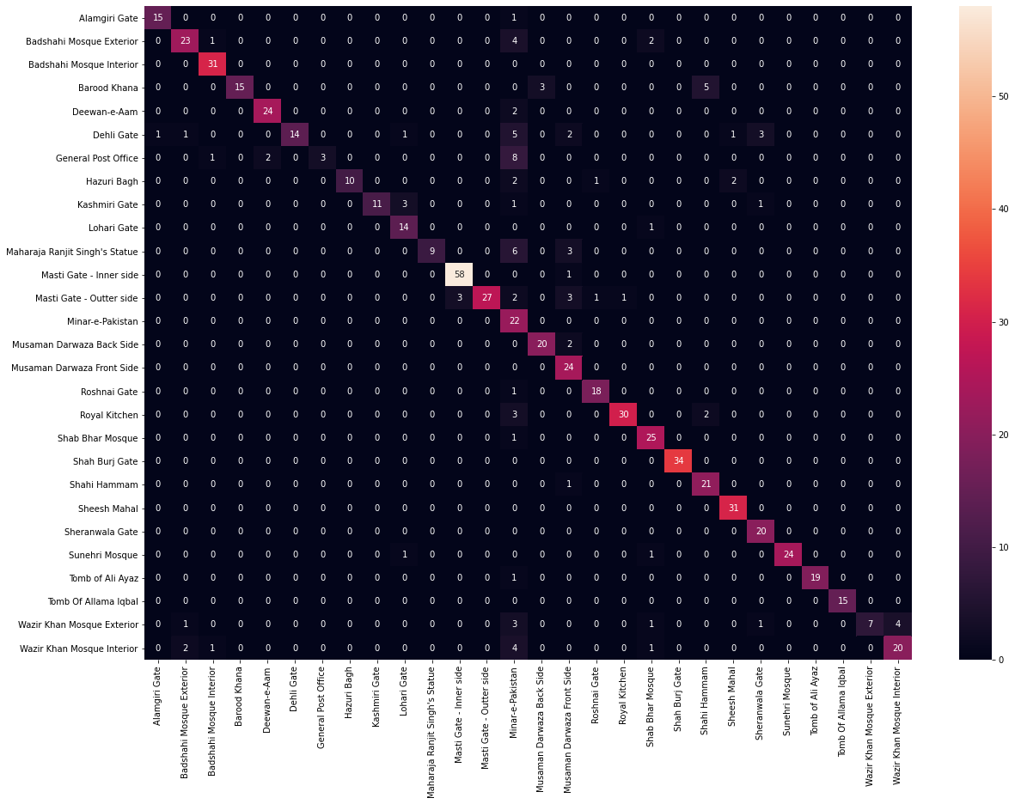
UNIVERSITY OF CENTRAL PUNJAB
Experimentation Results and Analysis
Confusion Matrix
States 85% Accuracy

Slide 75
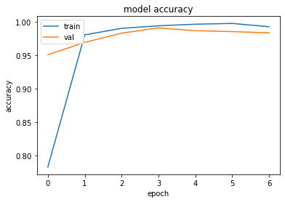
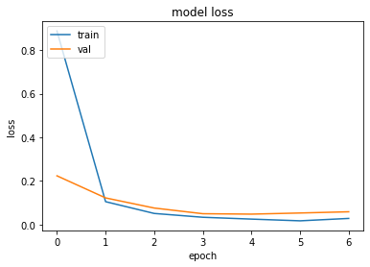
UNIVERSITY OF CENTRAL PUNJAB
Experimentation Results and Analysis
Pre-trained Resnet 50 with Augmentation & with Early Stopping Criteria on RGB images and Whole Dataset

Slide 76
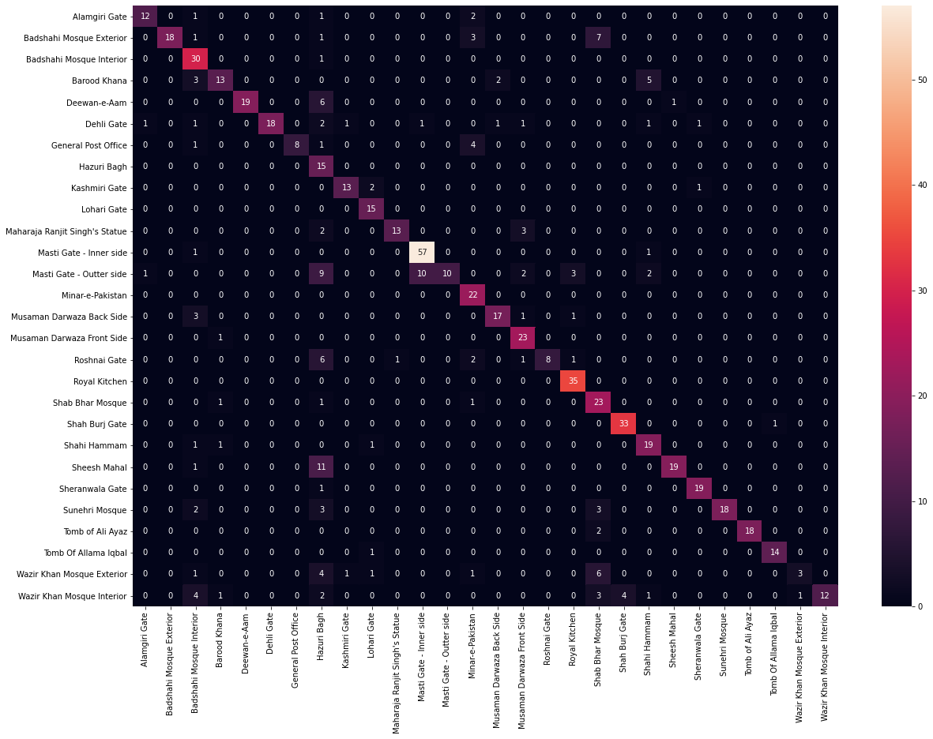
UNIVERSITY OF CENTRAL PUNJAB
Experimentation Results and Analysis
Confusion Matrix
Notes:
Conclusion:
For model trained on whole landmark’s dataset(Model-2) early stopping fully performed its task yet its not as accurate as ResNet (model-1) trained on whole + cropped even if that was stopped due to time constraints.

Slide 77
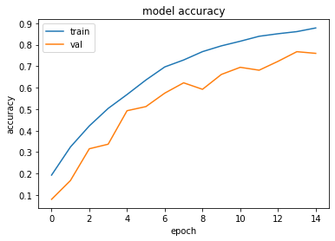
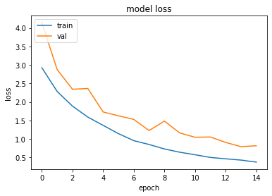
UNIVERSITY OF CENTRAL PUNJAB
Experimentation Results and Analysis
Resnet 50 Architecture without Weights on RGB Images of Whole + Parts Dataset

Slide 78
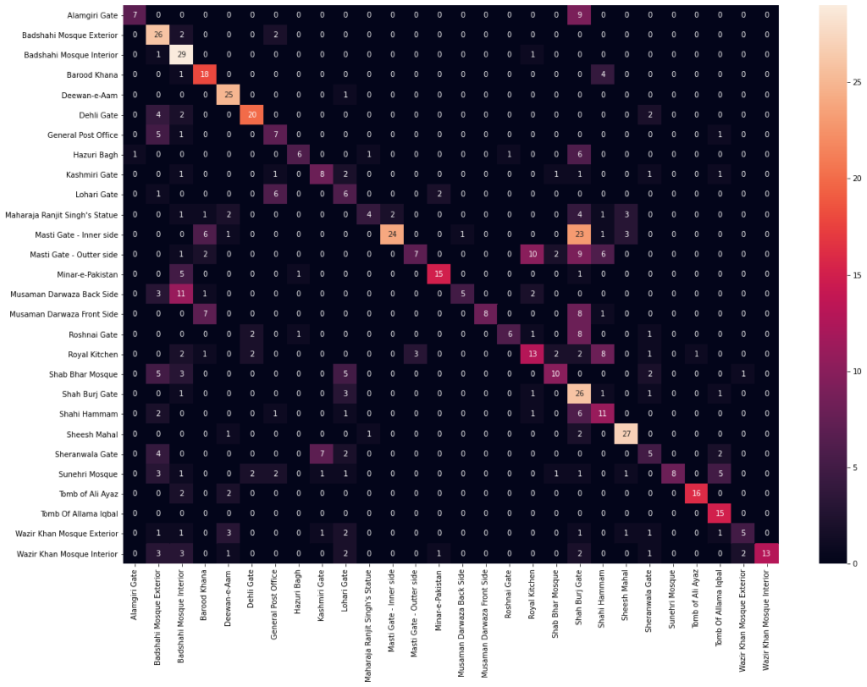
UNIVERSITY OF CENTRAL PUNJAB
Experimentation Results and Analysis
Confusion Matrix
Notes:
Conclusion:
One can see that while using RGB images to train ResNet with non-trained weights, in model-7 a trend has been started building as, in case of even pre trained models accuracy within models trained on just whole landmark dataset wasn’t as good as Whole + Cropped so we can get intuition of it ahead of implementation, while in case of model-8 it shown much better results as firstly RGB is used (For which ResNet was built for) secondly dataset included Whole + Cropped dataset, along with 15 epochs were used.

Slide 79
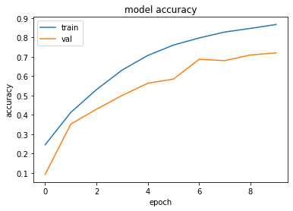
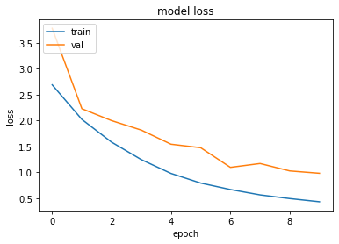
UNIVERSITY OF CENTRAL PUNJAB
Experimentation Results and Analysis
Resnet 50 Architecture without Weights on Grayscale Images of Whole + Parts Dataset

Slide 80
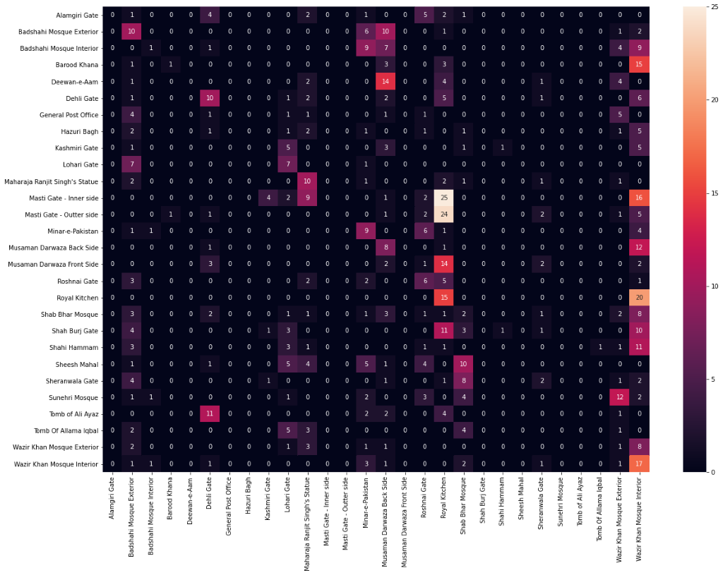
UNIVERSITY OF CENTRAL PUNJAB
Experimentation Results and Analysis
Confusion Matrix
Notes:
Conclusion: We already anticipated the results as we were working with non-trained weights of ResNet which originally took 14 days to train for 1000 classes, secondly the fact that Resnet is infused with CONV 1x1 was another reason for not promising results as our input images wasn’t carrying any channel(Color-> RGB) information causing deviation from the basics on for which ResNet was built for as a solution in optimization phase we will be trying to implement ResNet model again without adding conv 1x1 to make it compatible with gray scaled images specifically.

Slide 81
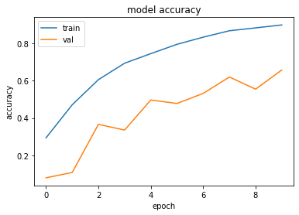
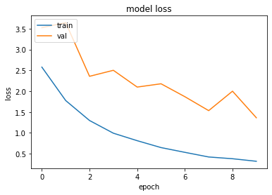
UNIVERSITY OF CENTRAL PUNJAB
Experimentation Results and Analysis
Resnet 50 Architecture without Weights on RGB Images of Whole Landmarks Dataset

Slide 82
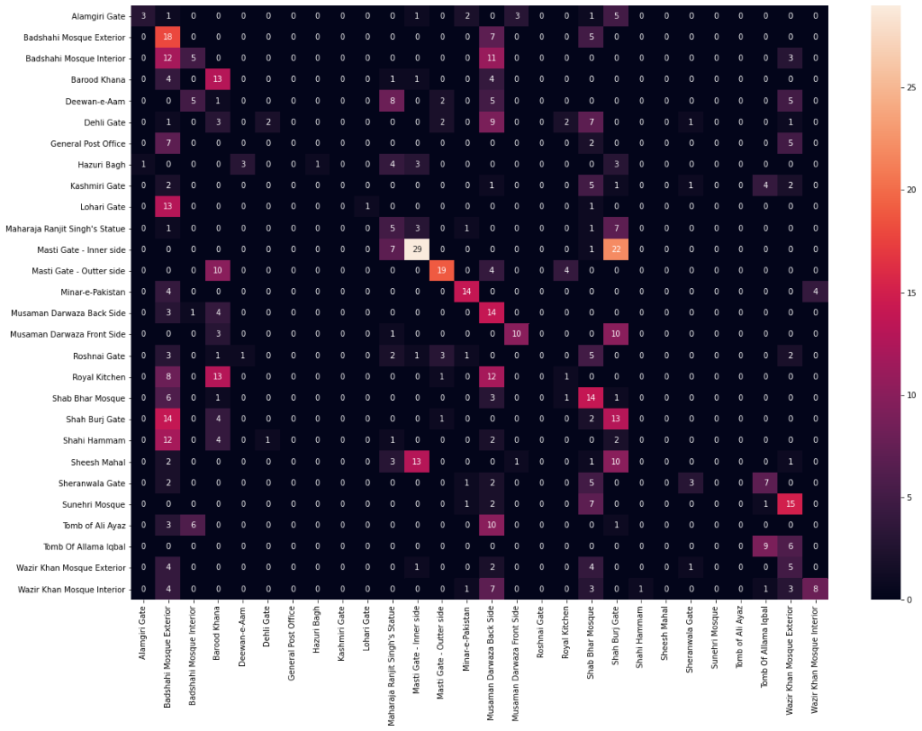
UNIVERSITY OF CENTRAL PUNJAB
Experimentation Results and Analysis
Confusion Matrix
Notes:
Conclusion:
For model trained on whole landmark’s dataset(Model-2) early stopping fully performed its task yet its not as accurate as ResNet (model-1) trained on whole + cropped even if that was stopped due to time constraints.

Slide 83
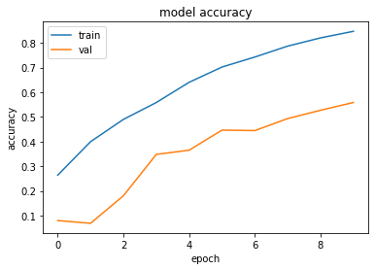
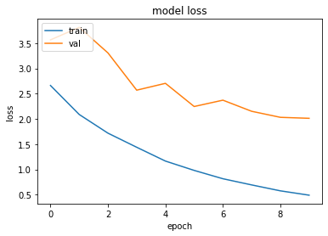
UNIVERSITY OF CENTRAL PUNJAB
Experimentation Results and Analysis
Resnet 50 Architecture without Weights on Grayscale Images of Whole Landmarks Dataset

Slide 84
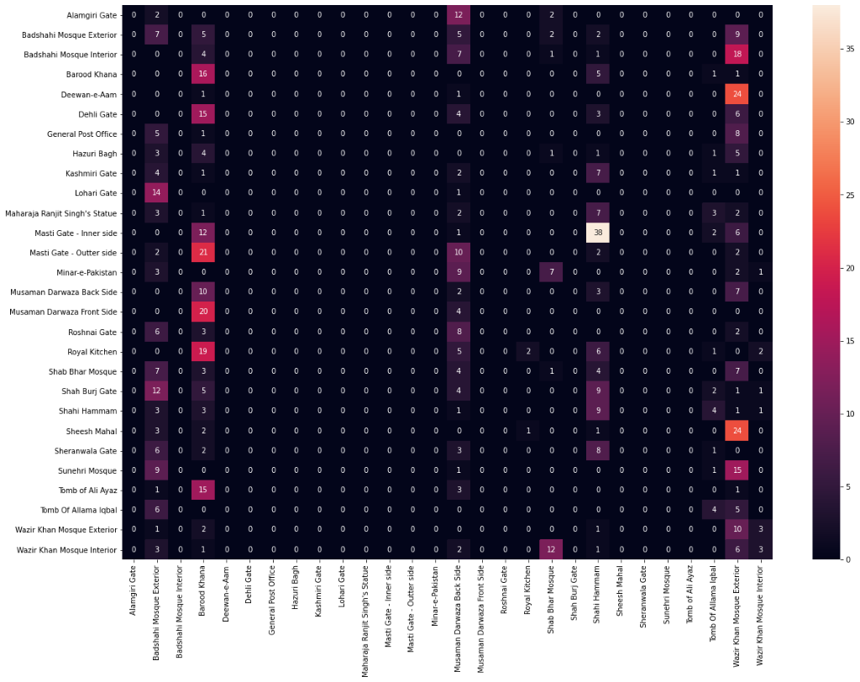
UNIVERSITY OF CENTRAL PUNJAB
Experimentation Results and Analysis
Confusion Matrix
Notes:
Conclusion:
For model trained on whole landmark’s dataset(Model-2) early stopping fully performed its task yet its not as accurate as ResNet (model-1) trained on whole + cropped even if that was stopped due to time constraints.

Slide 85
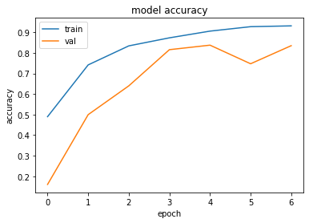
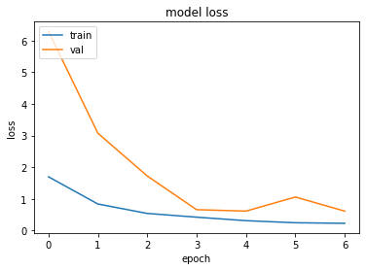
UNIVERSITY OF CENTRAL PUNJAB
Experimentation Results and Analysis
InceptionV3 Architecture without Weights and augmentation on RGB Images of Whole + Part Dataset

Slide 86

UNIVERSITY OF CENTRAL PUNJAB
Experimentation Results and Analysis
Confusion Matrix
States 75% Accuracy
Notes:
Conclusion:
Experiments conducted in pre working shown that inception required large amount of data and at that time we weren’t able to gathered much data using web scraping considering this fact we gave it another chance as we are now having sufficient amount of data. Our first major inception has shown quite encouraging results, even without using pre-trained model.

Slide 87
UNIVERSITY OF CENTRAL PUNJAB
Experimentation Results and Analysis
Problems faced in these experiments are that all of these were performed on Kaggle where maximum allowed execution time is 9 hours. So limited numbers of epochs were run
After problems solved like ‘security issue on login’ and ‘access denieds’ on TeamViewer by cooperation of Project Office and IT Support, we were able to run the final experiment which took 22 hours to run and results were astonishing

Slide 88


UNIVERSITY OF CENTRAL PUNJAB
Experimentation Results and Analysis
VGGNet-16 Architecture Pretrained with augmentation on RGB Images of Whole + Part Dataset

Slide 89

UNIVERSITY OF CENTRAL PUNJAB
Experimentation Results and Analysis
Confusion Matrix
States 98% Accuracy
Notes:
Conclusion: with consideration of the fact that VGG performed not as good as ResNet on dataset collected by web scrapoing we gave it an other shot, as we were interested in finding the change due to change in amount of dataset and results were quite astonishing.

Slide 90
UNIVERSITY OF CENTRAL PUNJAB
Results Achieved from Experimentations
Methods | Weights | Color Mode of Images | Dataset Variation | Augmentation | Early Stopping | Val Accuracy
ResNet-50 | ✓ | RGB | Whole + Part | ✓ | X | 99%
ResNet-50 with 3 dense layers | ✓ | RGB | Whole | ✓ | X | 99.65%
ResNet-50 | ✓ | RGB | Whole + Part | ✓ | ✓ | 99.2%
ResNet-50 with 3 dense layers | ✓ | RGB | Whole | ✓ | ✓ | 99.8%
ResNet-50 | X | RGB | Whole + Part | ✓ | X | 78%
ResNet-50 | X | Grayscale | Whole + Part | ✓ | X | 73%
ResNet-50 | X | RGB | Whole | ✓ | X | 68%
ResNet-50 | X | Grayscale | Whole | ✓ | X | 57%
InceptionV3 | X | RGB | Whole + Part | ✓ | ✓ | 84%
VGG-16 | ✓ | RGB | Whole + Part | ✓ | ✓ | 96.4%

Slide 91
UNIVERSITY OF CENTRAL PUNJAB
Target Final Results till Phase 1
 | Accuracy | Variance In Light | Variance in Angle/Size | Description | Geo-Info
Microsoft API | 11.8% | X | X | Cloud landmark recognition API | X
Google API | 35.7% | X | X | Cloud landmark recognition API | X
Tour The World | 46.3% | X | X | Image retrieval from a local landmark database | X
Scene Maps | 80.65% | X | X | Image retrieval from a local landmark database | X
Chinese Landmarks Recognition | 72.55% | X | X | iOS landmark recognition application | X
Indian Monument Recognition | 92.7% | X | ✓ | Framework for monument recognition | X
Cloud Mail.ru Group | 95% | X | ✓ | Landmark recognition framework deployed on Cloud-based application | ✓
Case Study of Istanbul | 96.3% | X | X | iOS landmark recognition application | X
Our Proposed Solution | 80%+ | ✓ | ✓ | Android/cross-platform landmark recognition application | Maybe

Slide 92
UNIVERSITY OF CENTRAL PUNJAB
Target Final Results Now
 | Accuracy | Variance In Light | Variance in Angle/Size | Description | Geo-Info
Microsoft API | 11.8% | X | X | Cloud landmark recognition API | X
Google API | 35.7% | X | X | Cloud landmark recognition API | X
Tour The World | 46.3% | X | X | Image retrieval from a local landmark database | X
Scene Maps | 80.65% | X | X | Image retrieval from a local landmark database | X
Chinese Landmarks Recognition | 72.55% | X | X | iOS landmark recognition application | X
Indian Monument Recognition | 92.7% | X | ✓ | Framework for monument recognition | X
Cloud Mail.ru Group | 95% | X | ✓ | Landmark recognition framework deployed on Cloud-based application | ✓
Case Study of Istanbul | 96.3% | X | X | iOS landmark recognition application | X
Our Proposed Solution | 80%+ | ✓ | ✓ | Android/cross-platform landmark recognition application | Maybe
Target Accuracy is achieved more than this

Slide 93
UNIVERSITY OF CENTRAL PUNJAB
Target Final Results Now
 | Accuracy | Variance In Light | Variance in Angle/Size | Description | Geo-Info
Microsoft API | 11.8% | X | X | Cloud landmark recognition API | X
Google API | 35.7% | X | X | Cloud landmark recognition API | X
Tour The World | 46.3% | X | X | Image retrieval from a local landmark database | X
Scene Maps | 80.65% | X | X | Image retrieval from a local landmark database | X
Chinese Landmarks Recognition | 72.55% | X | X | iOS landmark recognition application | X
Indian Monument Recognition | 92.7% | X | ✓ | Framework for monument recognition | X
Cloud Mail.ru Group | 95% | X | ✓ | Landmark recognition framework deployed on Cloud-based application | ✓
Case Study of Istanbul | 96.3% | X | X | iOS landmark recognition application | X
Our Proposed Solution | 80%+ | ✓ | ✓ | Android/cross-platform landmark recognition application | Maybe
Target Accuracy is achieved instead more than this
To be achieved in Phase 3 (optimization phase)

Slide 94
UNIVERSITY OF CENTRAL PUNJAB
Target Final Results Now
 | Accuracy | Variance In Light | Variance in Angle/Size | Description | Geo-Info
Microsoft API | 11.8% | X | X | Cloud landmark recognition API | X
Google API | 35.7% | X | X | Cloud landmark recognition API | X
Tour The World | 46.3% | X | X | Image retrieval from a local landmark database | X
Scene Maps | 80.65% | X | X | Image retrieval from a local landmark database | X
Chinese Landmarks Recognition | 72.55% | X | X | iOS landmark recognition application | X
Indian Monument Recognition | 92.7% | X | ✓ | Framework for monument recognition | X
Cloud Mail.ru Group | 95% | X | ✓ | Landmark recognition framework deployed on Cloud-based application | ✓
Case Study of Istanbul | 96.3% | X | X | iOS landmark recognition application | X
Our Proposed Solution | 80%+ | ✓ | ✓ | Android/cross-platform landmark recognition application | Maybe
Achieved through our dataset which was collected in such a way for catering pose in variance issue and testing set included many samples of it as well.
Target Accuracy is achieved instead more than this
To be achieved in Phase 3 (optimization phase)

Slide 95
UNIVERSITY OF CENTRAL PUNJAB
Target Final Results Now
 | Accuracy | Variance In Light | Variance in Angle/Size | Description | Geo-Info
Microsoft API | 11.8% | X | X | Cloud landmark recognition API | X
Google API | 35.7% | X | X | Cloud landmark recognition API | X
Tour The World | 46.3% | X | X | Image retrieval from a local landmark database | X
Scene Maps | 80.65% | X | X | Image retrieval from a local landmark database | X
Chinese Landmarks Recognition | 72.55% | X | X | iOS landmark recognition application | X
Indian Monument Recognition | 92.7% | X | ✓ | Framework for monument recognition | X
Cloud Mail.ru Group | 95% | X | ✓ | Landmark recognition framework deployed on Cloud-based application | ✓
Case Study of Istanbul | 96.3% | X | X | iOS landmark recognition application | X
Our Proposed Solution | 80%+ | ✓ | ✓ | Android/cross-platform landmark recognition application | Maybe
Achieved through our dataset which was collected in such a way for catering pose in variance issue and testing set included many samples of it as well.
Target Accuracy is achieved instead more than this
To be achieved in Phase 3 (optimization phase)
Phase 4

Slide 96

UNIVERSITY OF CENTRAL PUNJAB
System Prototype
Screen 1

Slide 97

UNIVERSITY OF CENTRAL PUNJAB
System Prototype
Screen 2

Slide 98

UNIVERSITY OF CENTRAL PUNJAB
System Prototype
Screen 3

Slide 99
UNIVERSITY OF CENTRAL PUNJAB
Target Final Results Now
 | Accuracy | Variance In Light | Variance in Angle/Size | Description | Geo-Info
Microsoft API | 11.8% | X | X | Cloud landmark recognition API | X
Google API | 35.7% | X | X | Cloud landmark recognition API | X
Tour The World | 46.3% | X | X | Image retrieval from a local landmark database | X
Scene Maps | 80.65% | X | X | Image retrieval from a local landmark database | X
Chinese Landmarks Recognition | 72.55% | X | X | iOS landmark recognition application | X
Indian Monument Recognition | 92.7% | X | ✓ | Framework for monument recognition | X
Cloud Mail.ru Group | 95% | X | ✓ | Landmark recognition framework deployed on Cloud-based application | ✓
Case Study of Istanbul | 96.3% | X | X | iOS landmark recognition application | X
Our Proposed Solution | 80%+ | ✓ | ✓ | Android/cross-platform landmark recognition application | Maybe
Geo-Info will not be used for our project as it is computer vision based and should not take help of geo-information after discussing with advisor
Achieved through our dataset which was collected in such a way for catering pose in variation issue and testing set included many samples of it as well.
Target Accuracy is achieved instead more than it
To be achieved in Phase 3 (optimization phase)
X
Phase 4

Slide 100
UNIVERSITY OF CENTRAL PUNJAB
Future Directions for Phase-3
Optimizing the model
Catering to the issue of variation in light
Dataset maybe increased by turning daylight pictures to night to enhance the results for evening/night time landmarks recognition in obvious scenarios
Completion of Research Paper

Slide 101
UNIVERSITY OF CENTRAL PUNJAB
Thank you!!

